Slide 1
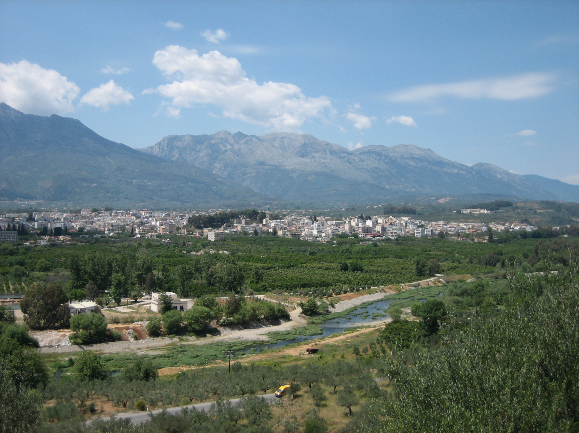
Hydrologic and Sediment Transport in a Complex Mediterranean Catchment
21st Century Watershed Technology Conference
Bari, IT, May 26-30, 2012
C Gamvroudis, N. Nikolaidis, N. Karalemas, V. Papadoulakis and O Tzoraki
Technical University of Crete and Lakonia Prefecture

Slide 2
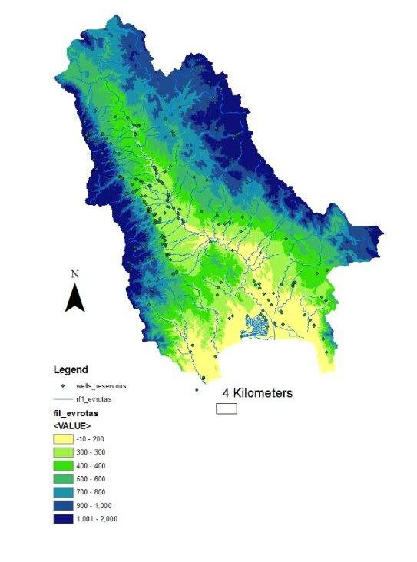
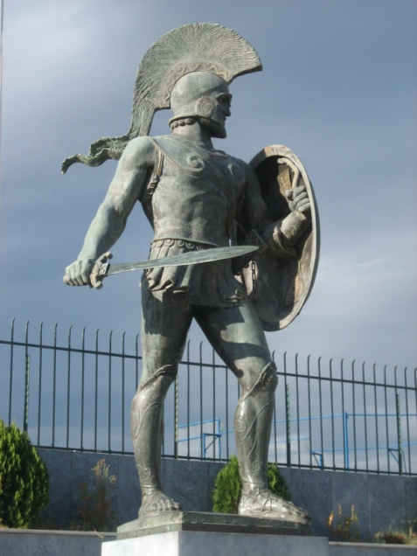
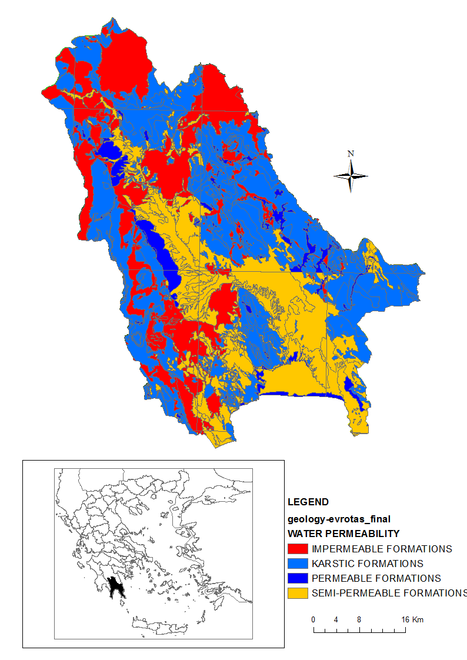
Parnonas Mountain
Evrotas River Basin
Taygetos Mountain

Slide 3
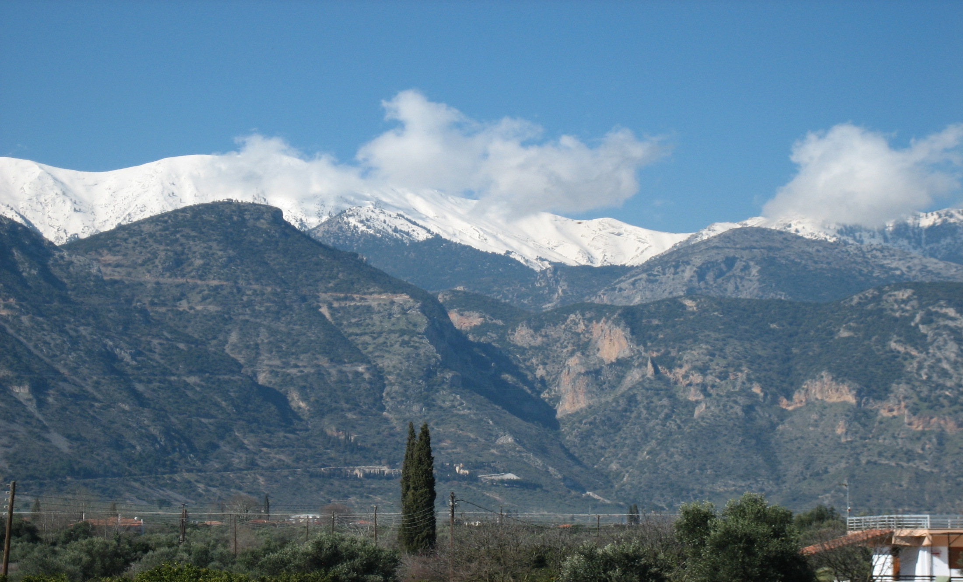
Ragged Morphology – Steep Slopes
(Slope >15% → 58%; Slope 5-15% → 29%; Slope <5% → 13%)

Slide 4
Natural reservoirs
→ Karst (60%) and
→ Alluvial deposits (22%)

Slide 5
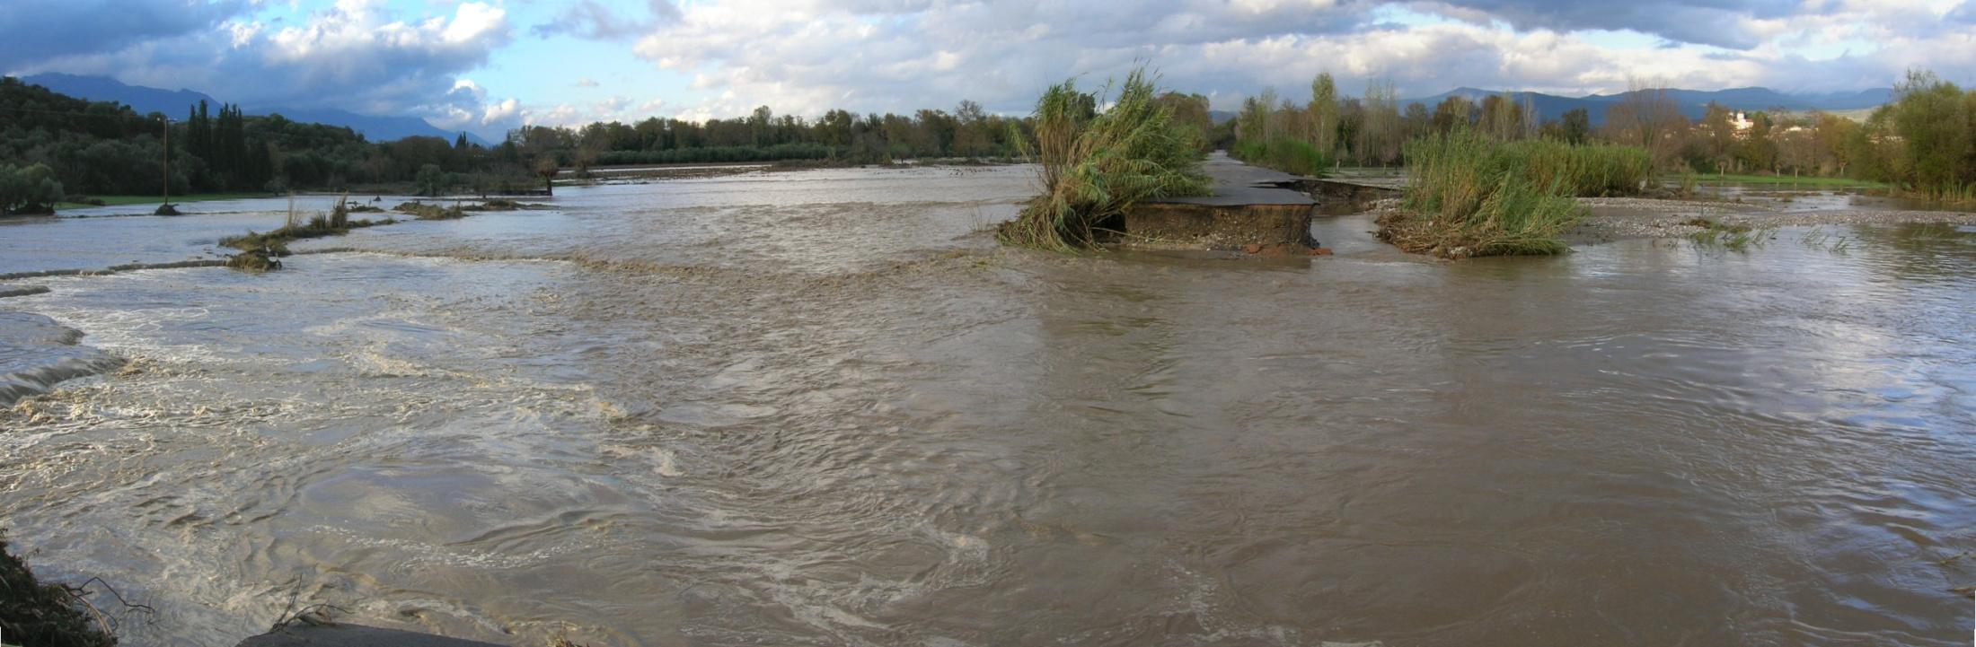
Flush Floods….

Slide 6
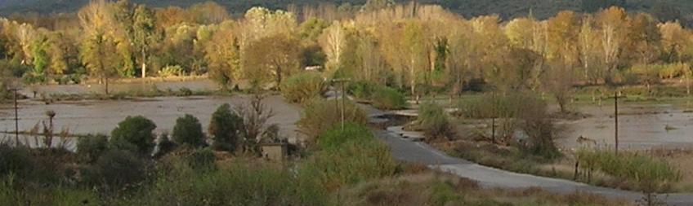
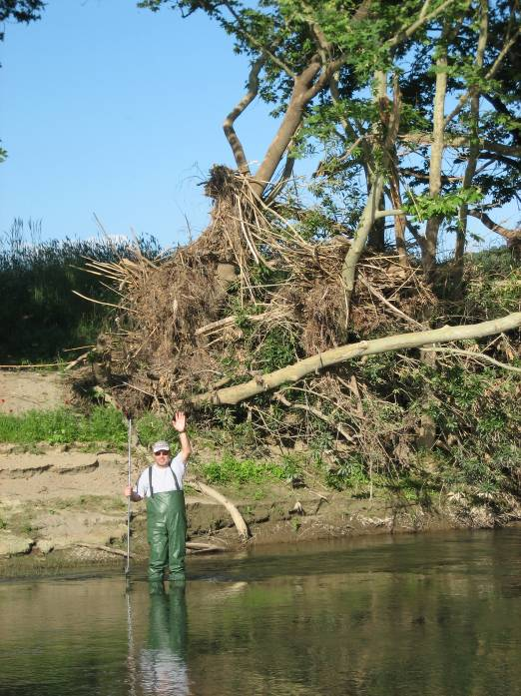
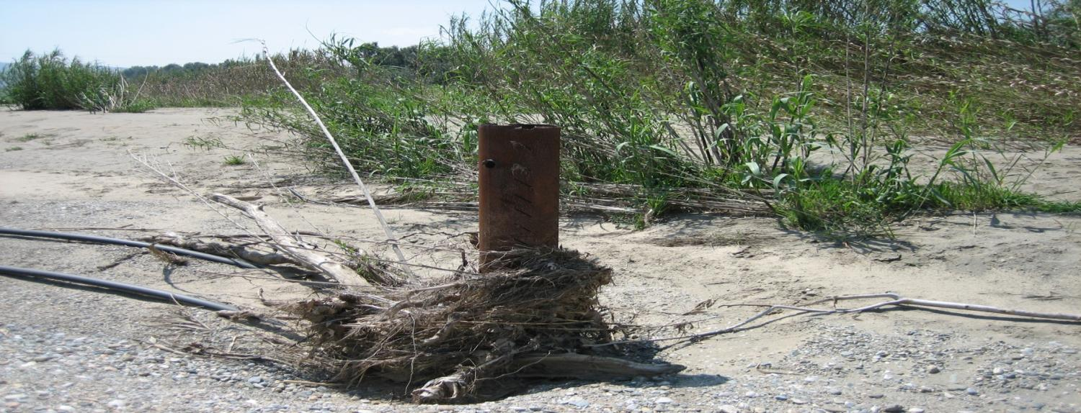
Floods

Slide 7
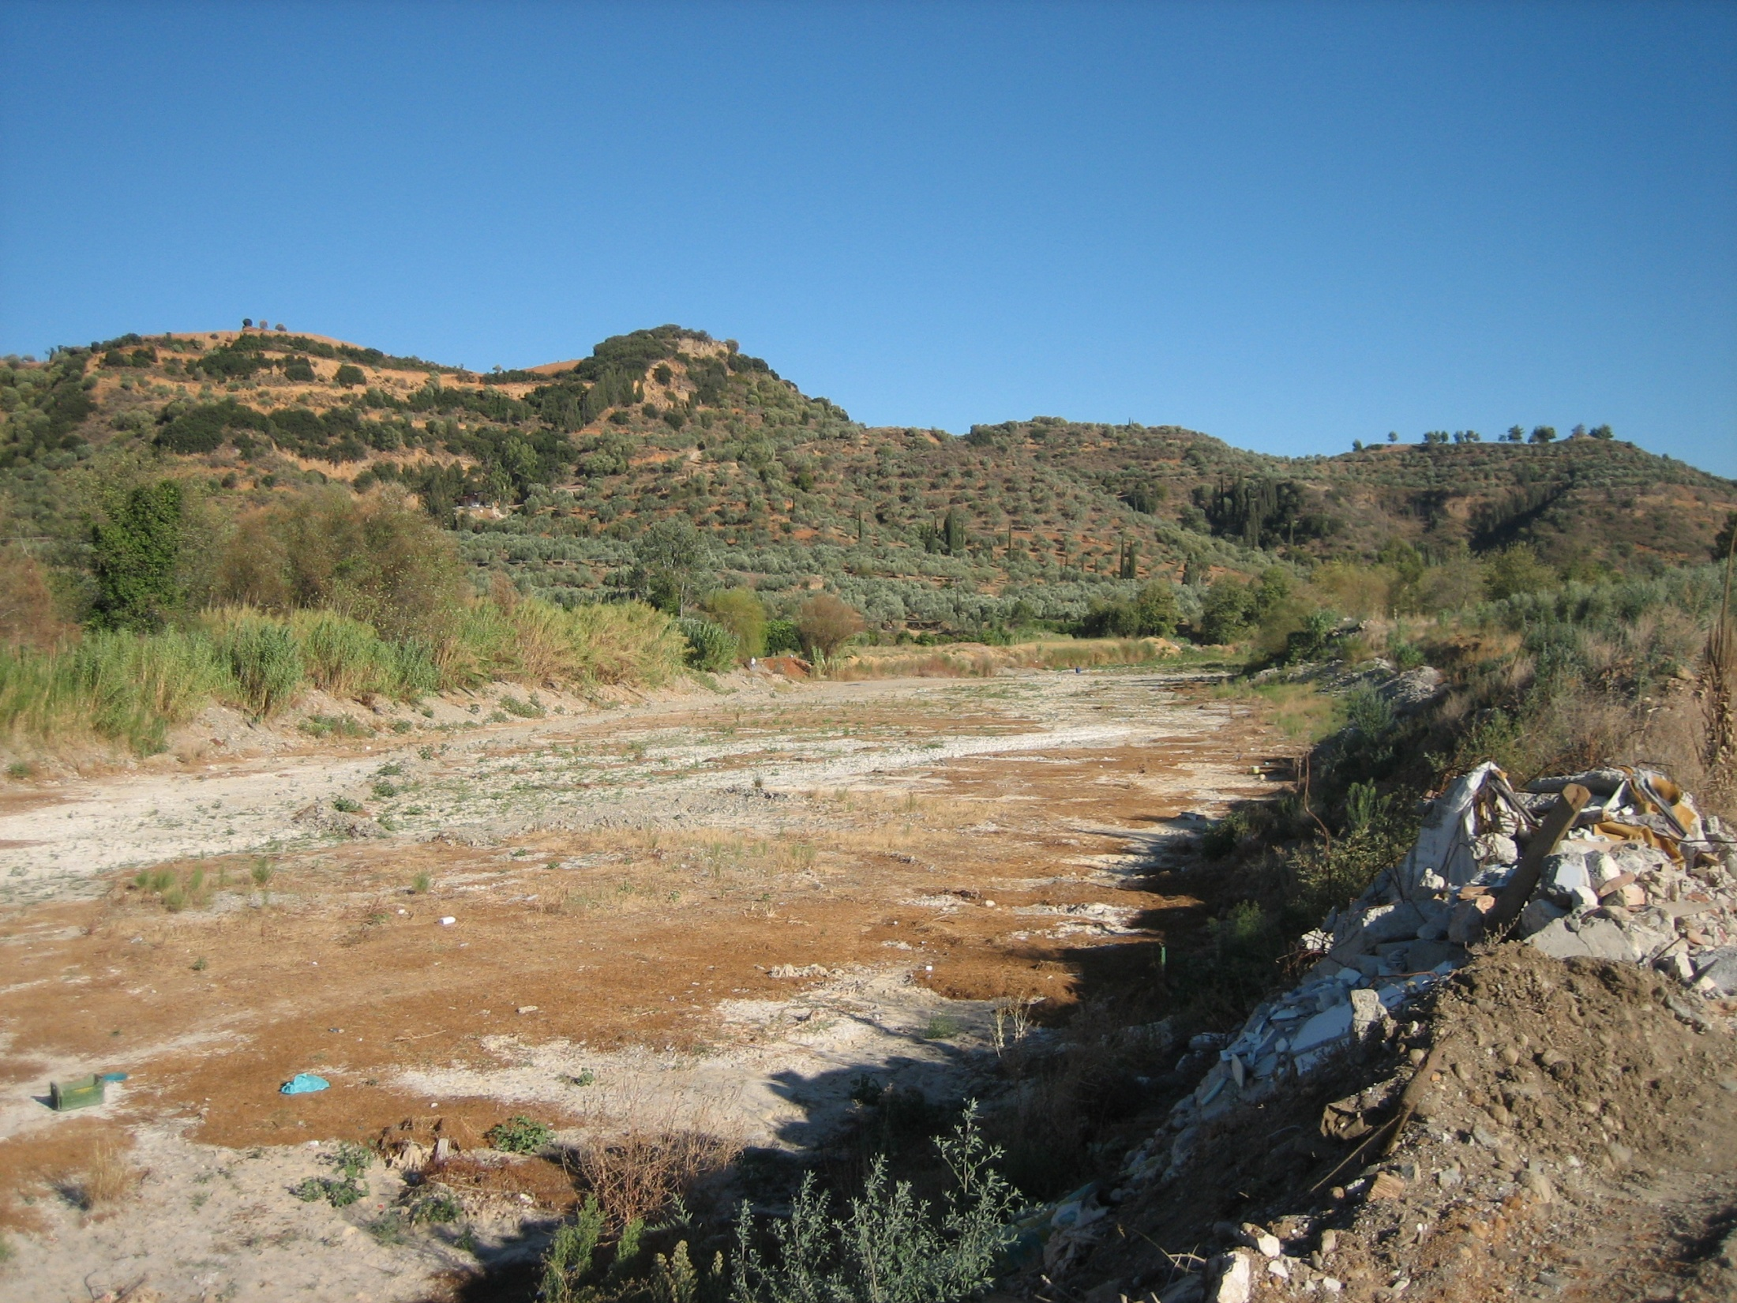
Drought
Evrotas River Basin

Slide 8
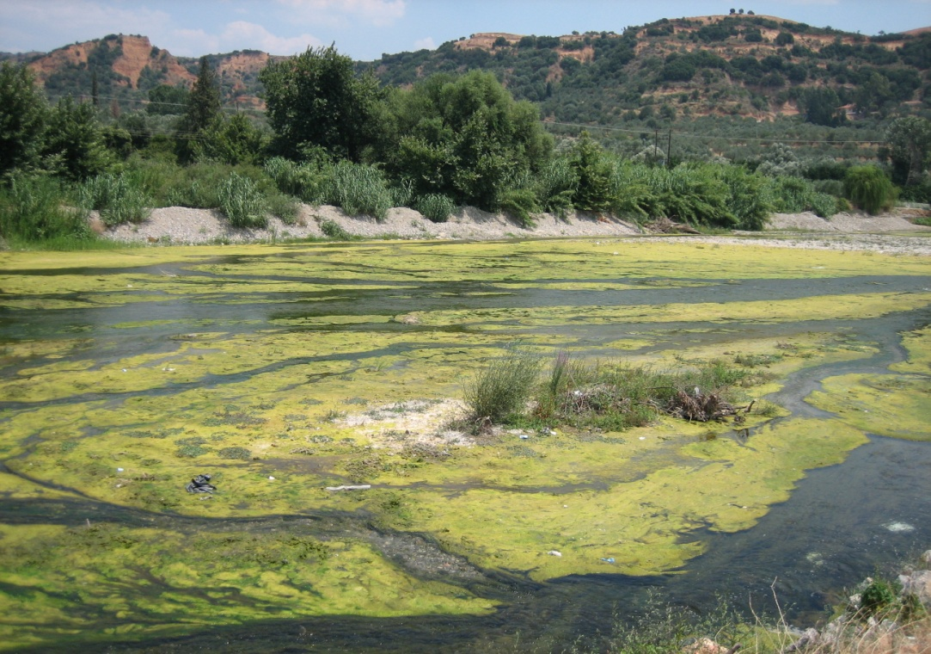
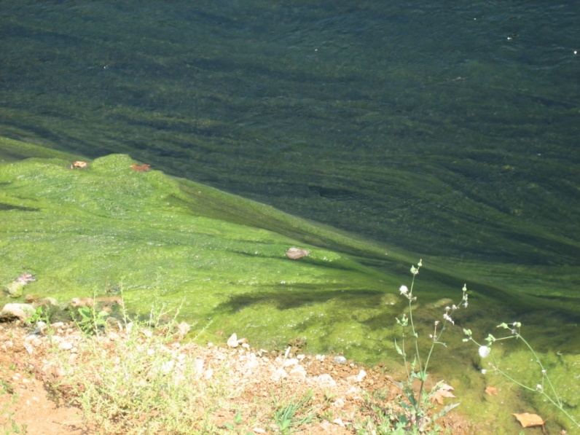
Evrotas River Basin
Eutrophication

Slide 9
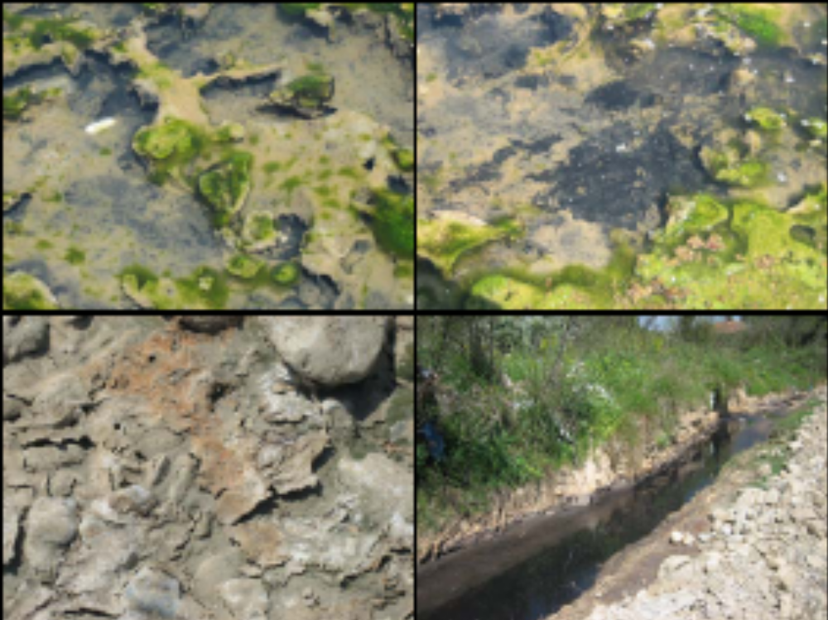
Evrotas River Basin
Olive Mill Waste Water

Slide 10
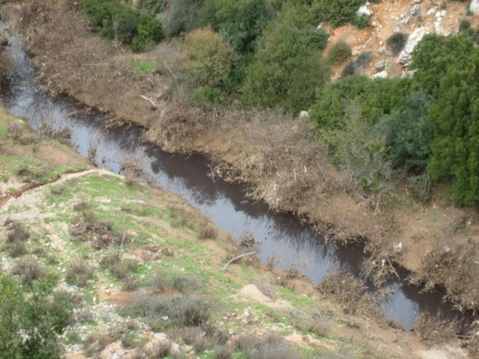
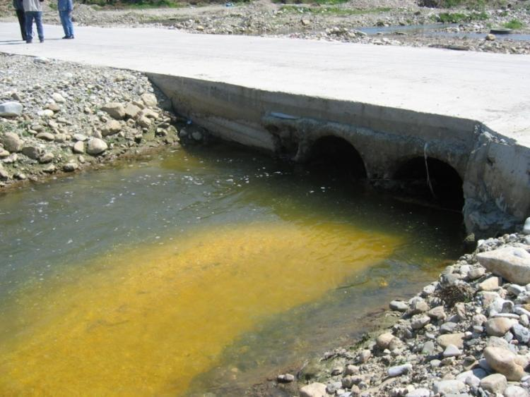
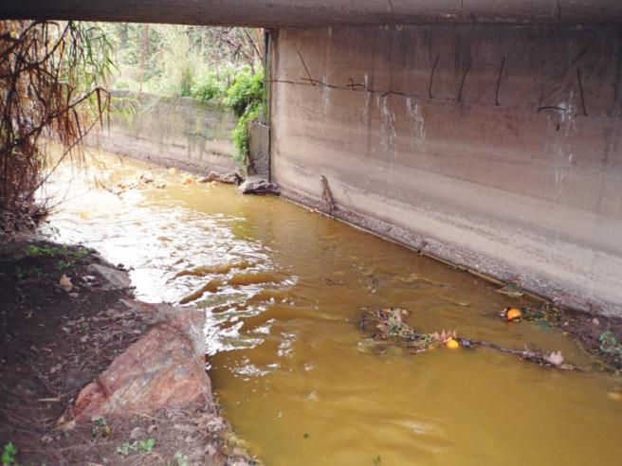
Pollution...

Slide 11
Hydrologic Pressures
Public drinking water and irrigation water wells and springs –
(3500 private wells not shown)

Slide 12
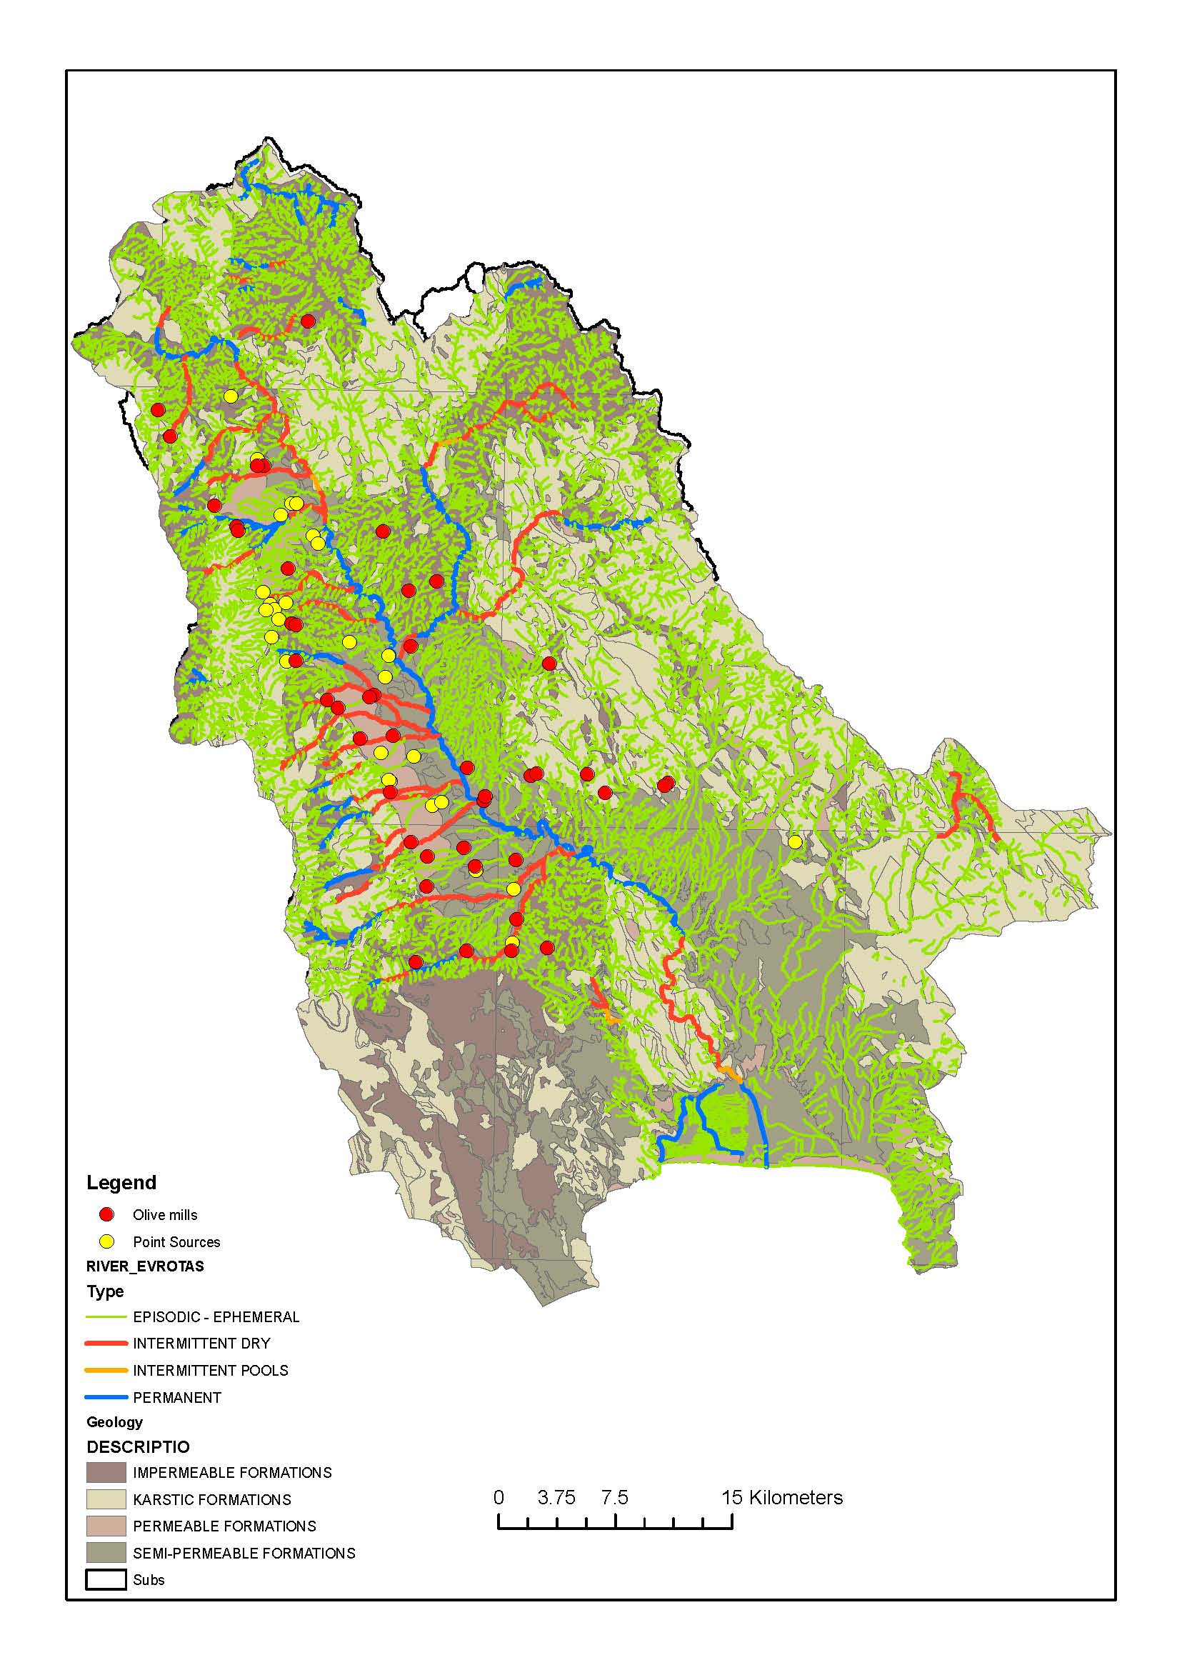
Hydrologic Status 2010
(wet year)
 | Number of River Segments | River Length, Km | % of Total Length
Permanent Flow | 600 | 179 | 3.5
Temporary Flow | 589 | 220 | 4.3
Episodic Flow | 14906 | 4744 | 92.2

Slide 13
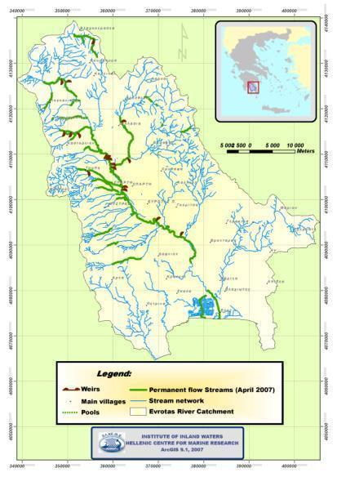
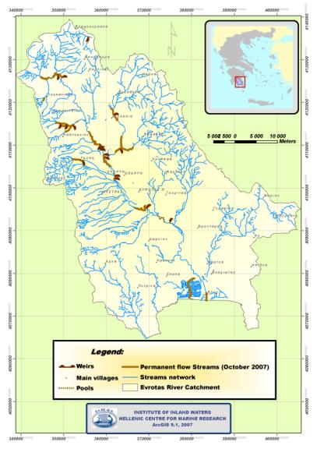
Hydrologic Status During Drought
April 2007
October 2007

Slide 14
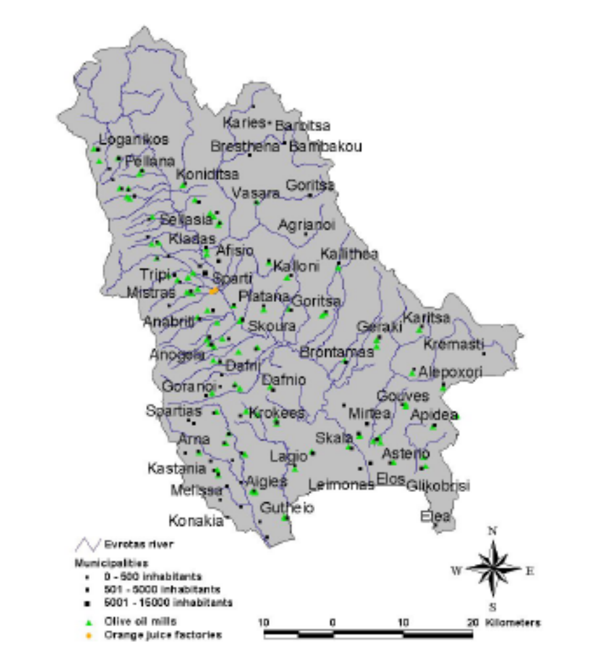
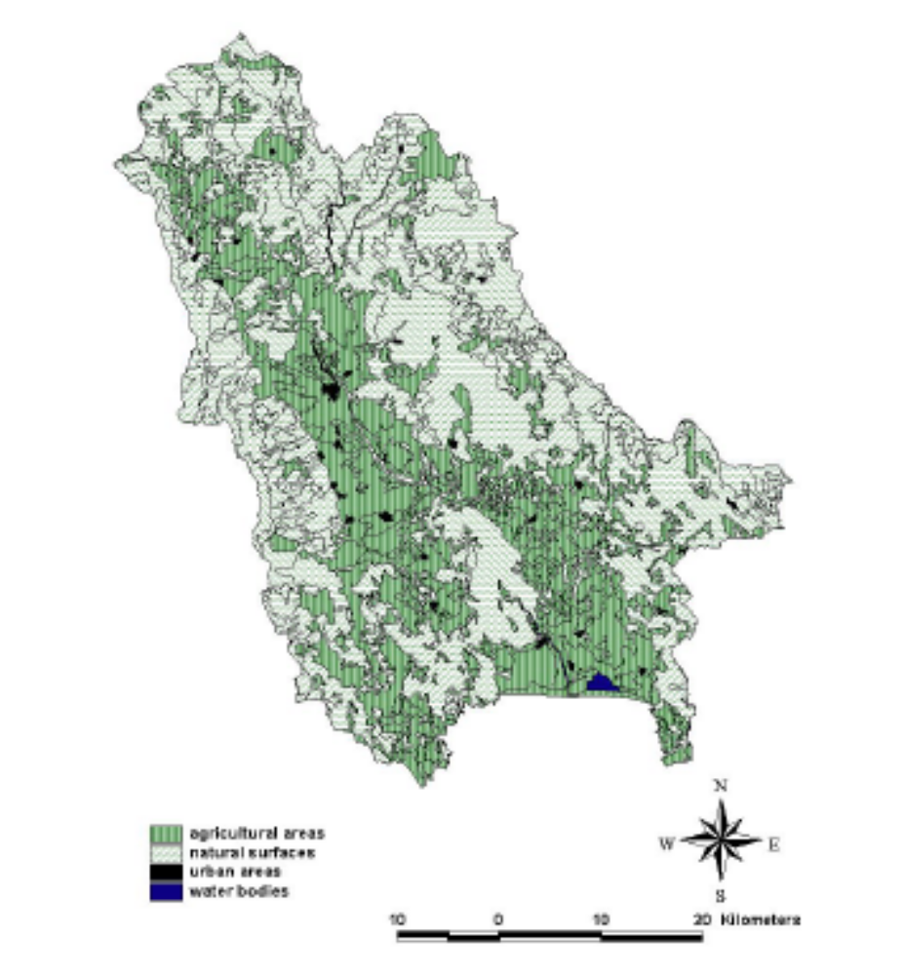
Environmental Pressures
Point Sources:
Waste water
Olive mill waste
Orange juice waste
Non-Point Sources
Agriculture (38%)
Livestock
Solid waste disposal sites
Sheep/goat 130,540
Chicken 58,070
Cow 1,729
Pig 100

Slide 15
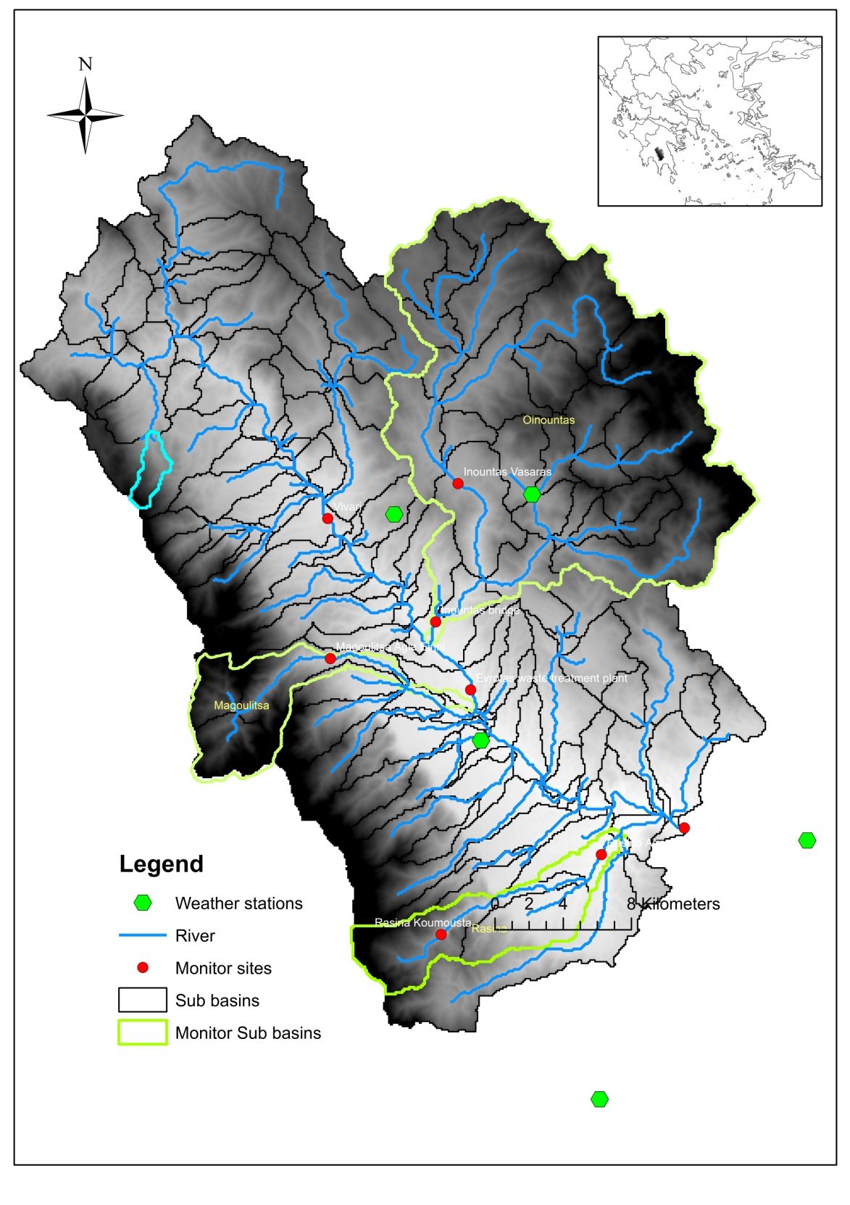
Sampling Network
Monitoring main corridor and 3 sub-catchments
9 gauging stations measuring flow
Monthly grab sampling for chemistry and sediments
Cross sections on sediment accumulation/loss
Dessication survey

Slide 16
Hydrologic simulation of SWAT
a) Vrontamas station b) Vivari station

Slide 17
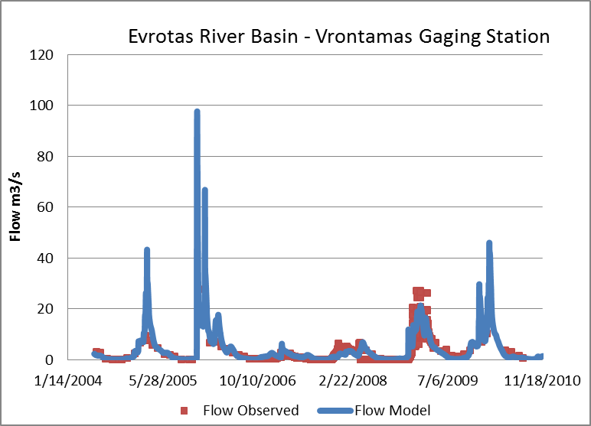
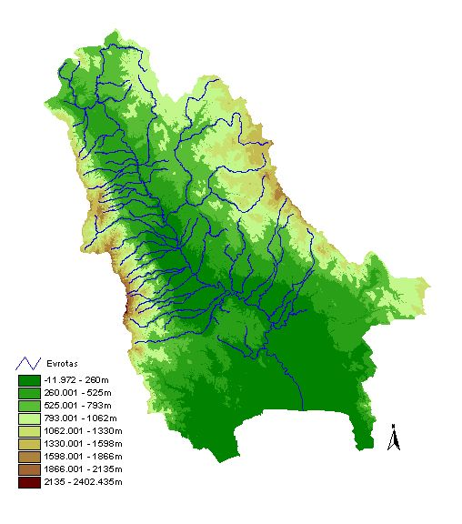
Annual Average Hydrologic Budget (2000-2011)
During drought years, runoff is less than 5%
ET=423 mm
(46.5%)
GW Losses = 297 mm (32.7%)
Runoff = 114 mm
(12.5%)
Precipitation = 909 mm
Irrigation and Abstractions = 57 mm or 77 Mm3/yr (7% - 900 mm/ha)

Slide 18
Evrotas river desiccation evolution
(January 2007-December 2007)

Slide 19
Spatial distribution of water yield
a) 2002-2003 (247 mm) b) 2006-2007 (48 mm) and c) 2008-2009 (167 mm)

Slide 20
Flow duration curve of the main river
a) 2002-2003 b) 2006-2007 and c) 2008-2009

Slide 21
SWAT sediment simulation
a) Vrontamas station b) Vivari station

Slide 22
3-D cross section image of Magoulitsa and Rasina reaches
3% error
12% error

Slide 23
Mean sediment yield (2000-2011)
The average sediment yield for the whole watershed was 1.24 t ha⁻¹ yr⁻¹.

Slide 24
Spatial distribution of sediment yield
a) 2002-2003 b) 2006-2007 and c) 2008-2009

Slide 25
Suspended sediment duration curves

Slide 26
Precipitation events vs sediment yield

Slide 27
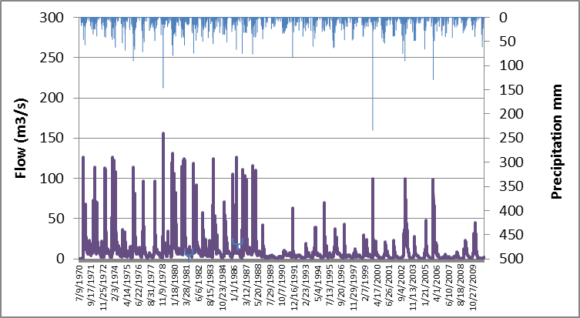
Climate Change at ERB

Slide 28
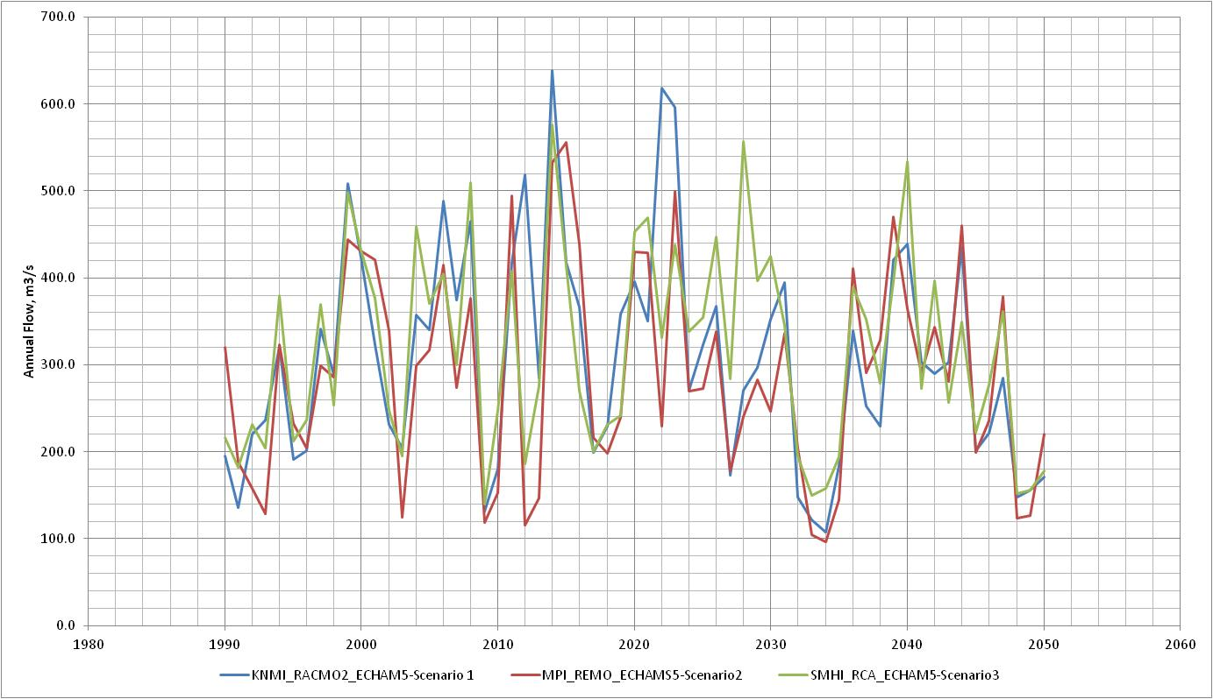
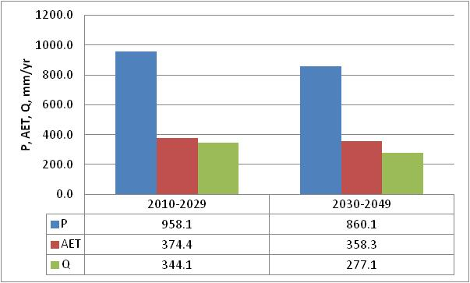
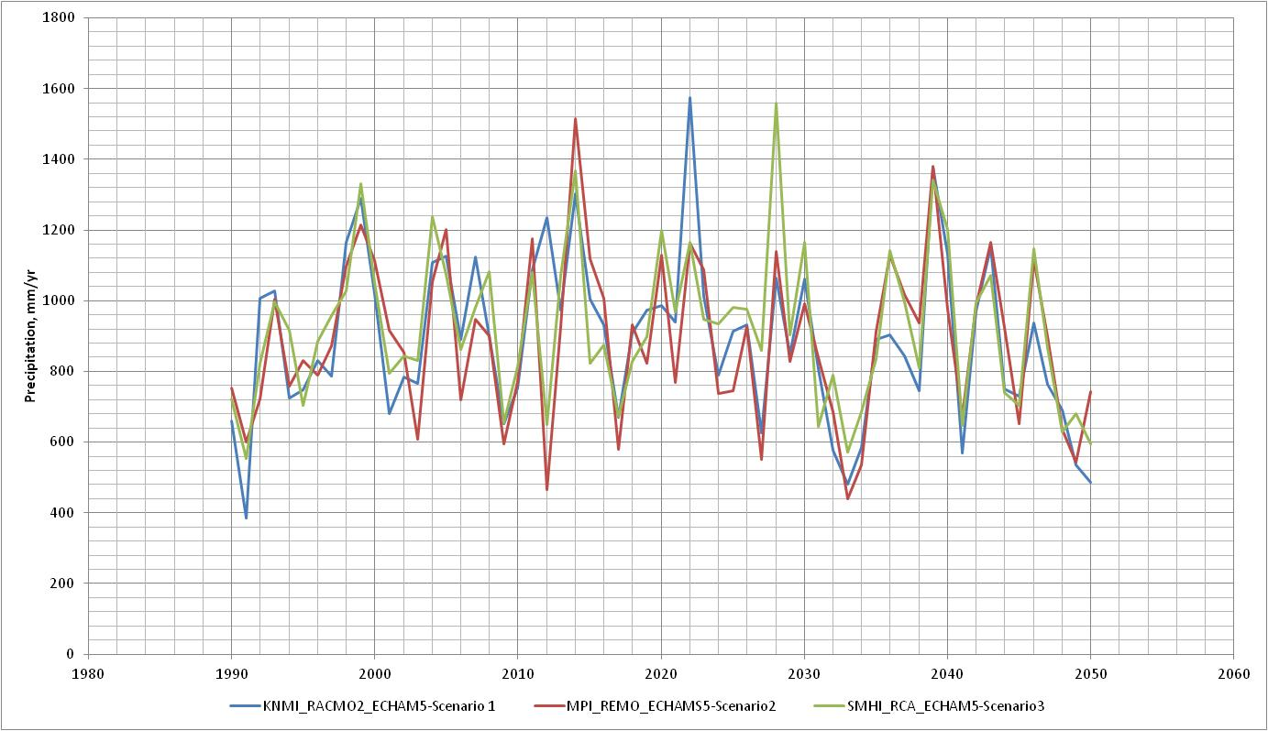
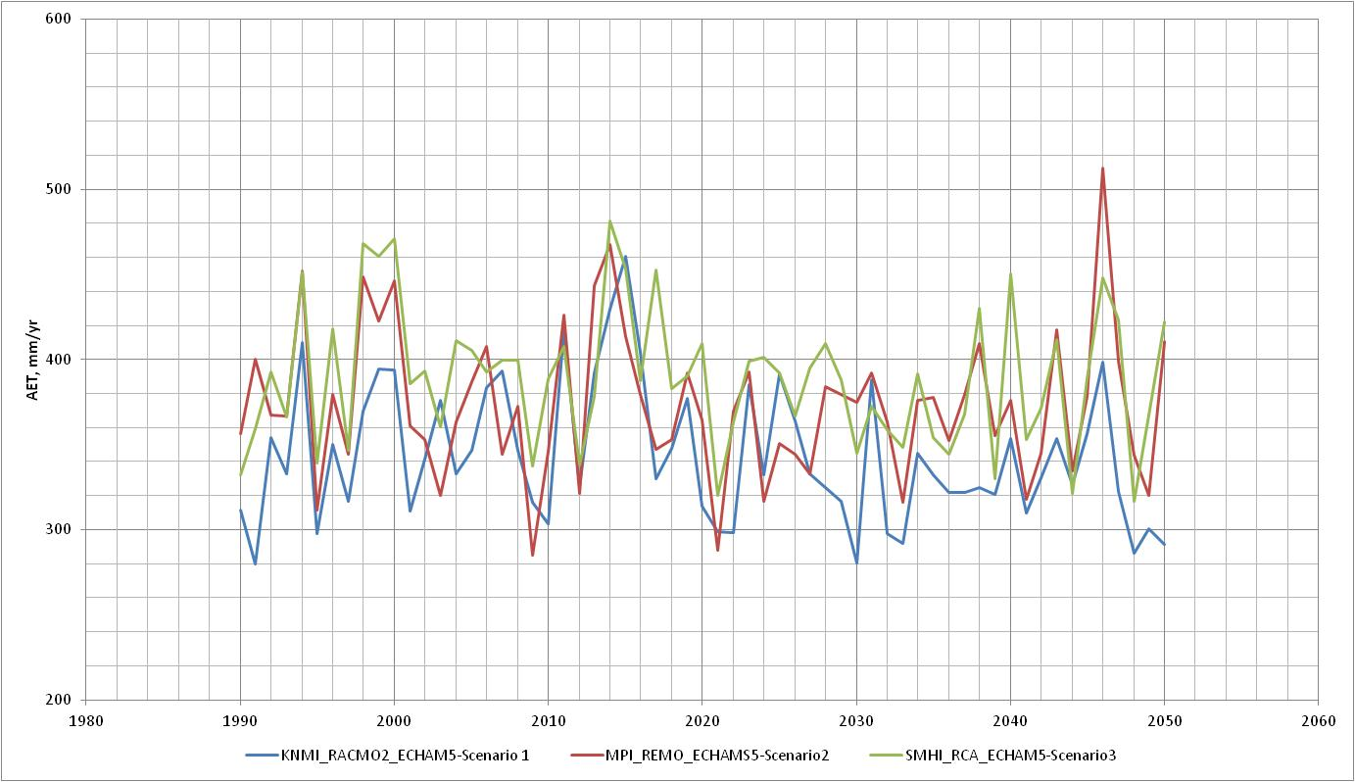
Climate Change Impacts at ERB
10% decrease in precipitation,
4% decrease in ET and
19% decrease in flow in 2030-2050
compared to 2010-2020

Slide 29
Evrotas River Basin – Program of Measures

Slide 30
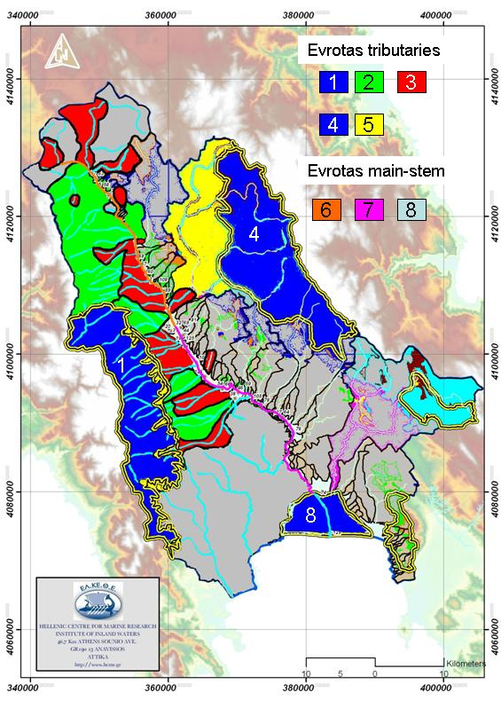
Water Bodies 1, 2, 4, 5, 6 and 8 have “Ecological Status of GOOD or above”
Water Bodies 3 and 7 have “Ecological Status of less than GOOD ”

Slide 31
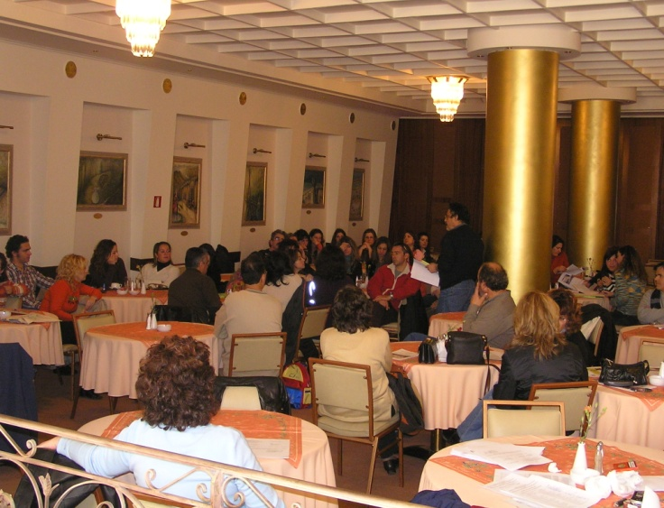
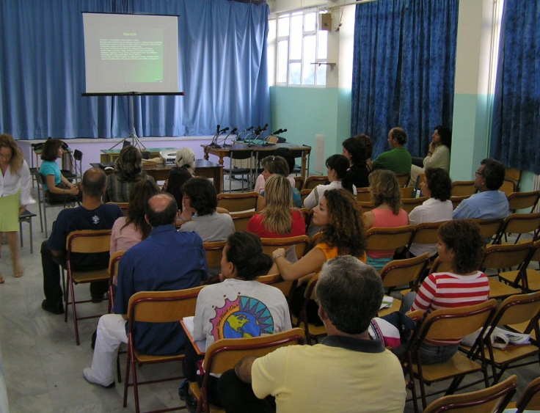
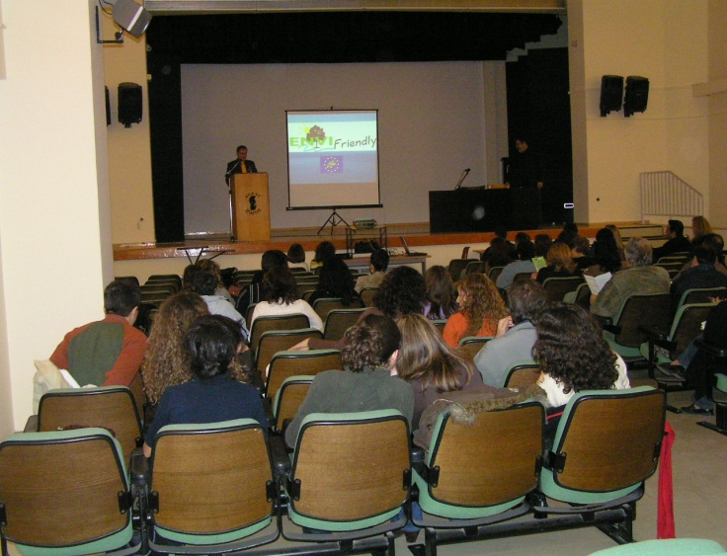
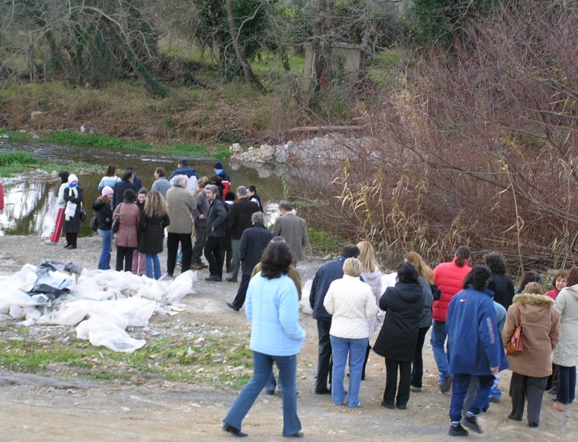
Stakeholder Involvement/Education

Slide 32
Environmental Objectives
The strategic objective of the Evrotas river basin management plan is the integrated management of the river basin’s water resources in such a way as to contribute to the:
improvement of the environment,
social cohesion,
value added to the local economy, and
improvement of the quality of life.

Slide 33
Aims
Create the conditions for sustainable rural development while improving the chemical and ecological quality of surface and ground waters in accordance with the Directive 2000/60.
Evrotas can be the comparative advantage that would lead the Prefecture of Laconia to the 21st Century.
Buy-in of actions by local stakeholders.

Slide 34
Program of Measures
The Program of Measures will be developed around the following five axes:
Agricultural development
Drinking and irrigation water
Reduction of point and non-point sources of pollution
Coordinated response to floods and droughts
Protection of biodiversity and restoration of river ecosystems

Slide 35
Environmental Pressures
Water abstractions
River sediment removal (sand and gravel)
River bank alterations
Municipal waste water, olive mill waste water, orange juice waste water, livestock waste disposal
Channelization
Water diversions for irrigation
Degradation of riparian vegetation

Slide 36
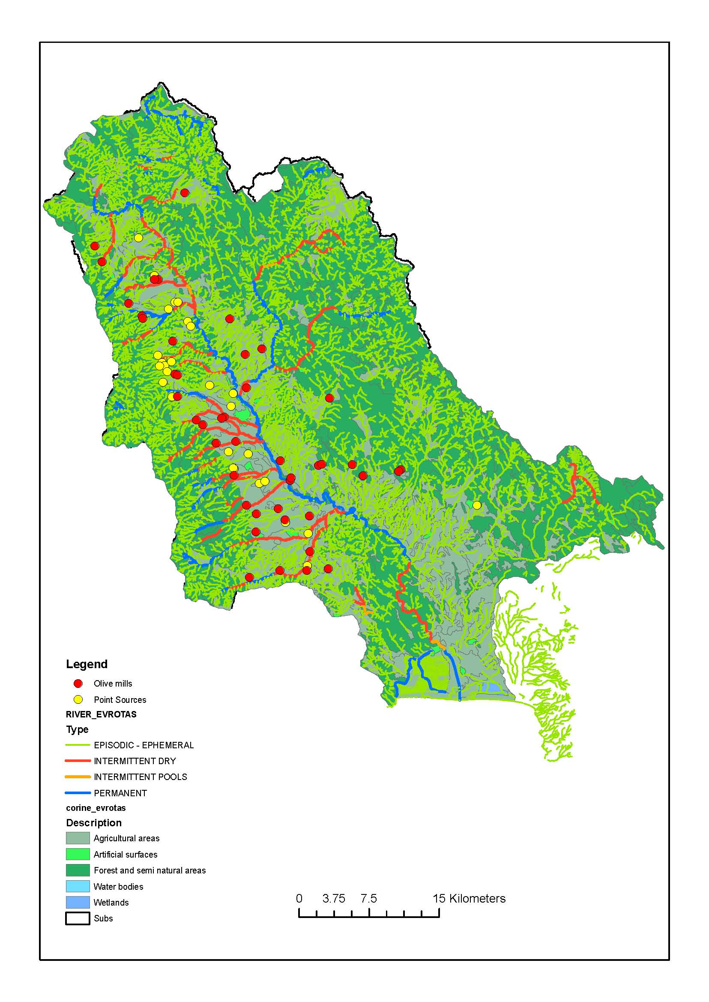

Slide 37
1. Agricultural Development
Sustainable agriculture
Crop rotations
Mixed livestock – crop practices
Agro-tourism

Slide 38
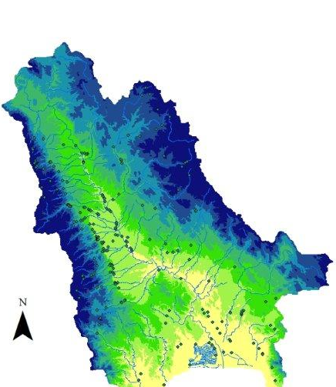
2. Drinking and Irrigation Water
Upgrade/Backup drinking water infrastructure
Municipal Drinking Water companies with specialized personnel to assure water quality
Rational pricing of water
Closed irrigation networks – drip irrigation etc
Irrigation water pricing according to consumption
Deficit irrigation
Reuse of marginal waters

Slide 39
3. Reduction of Point and Non-Point Source Pollution
Point source treatment and reuse (OMWW, OJWW, WW, Livestock waste)
Fertilizer use reductions
Riparian Zone restoration

Slide 40
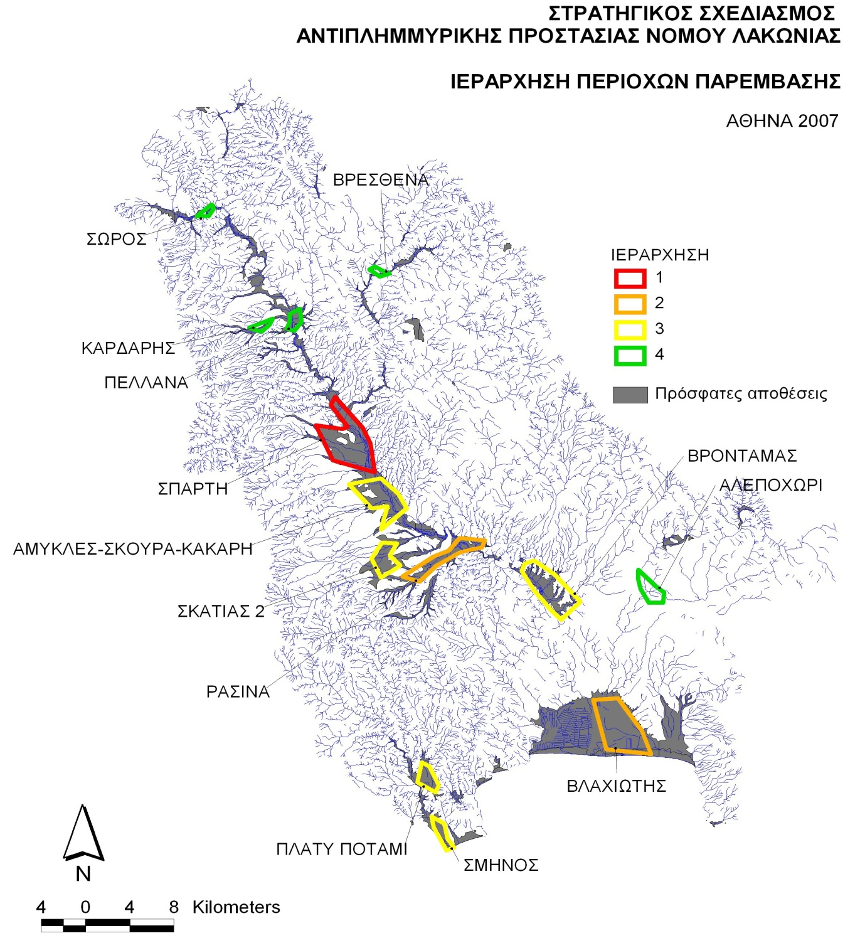
4. Coordinated response to floods and droughts
Protection measures for bank erosion
Small, recharge dams – high elevation
Drought management plans

Slide 41
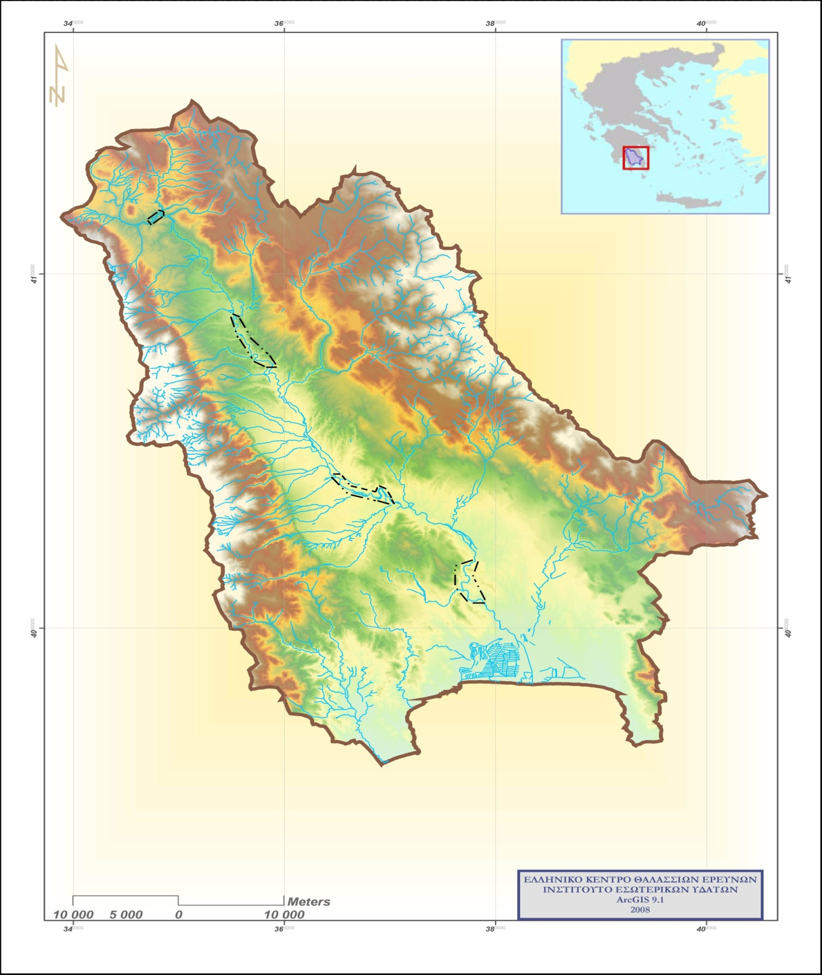
5. Protection of Biodiversity
Protection measures of riparian forests:
Kolliniotiko
Vivari springs
Skoura
Vrontamas
Ecological flow
Spring protection measures
1
2
3
4

Slide 42
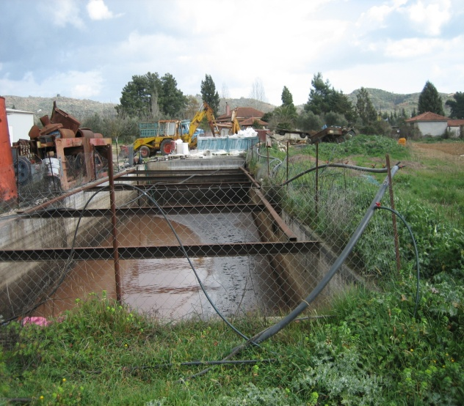
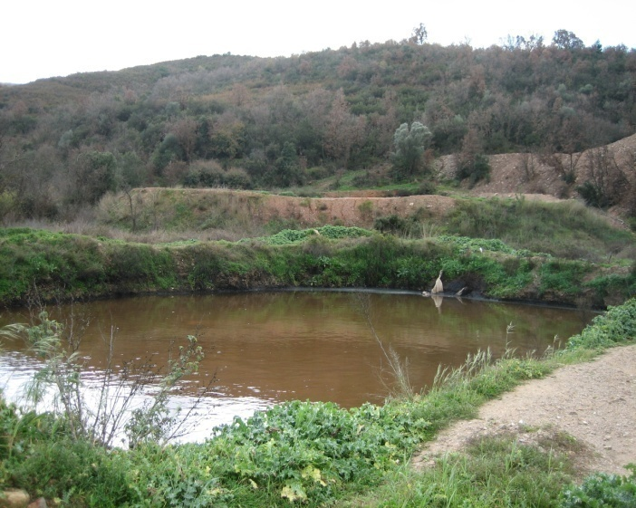
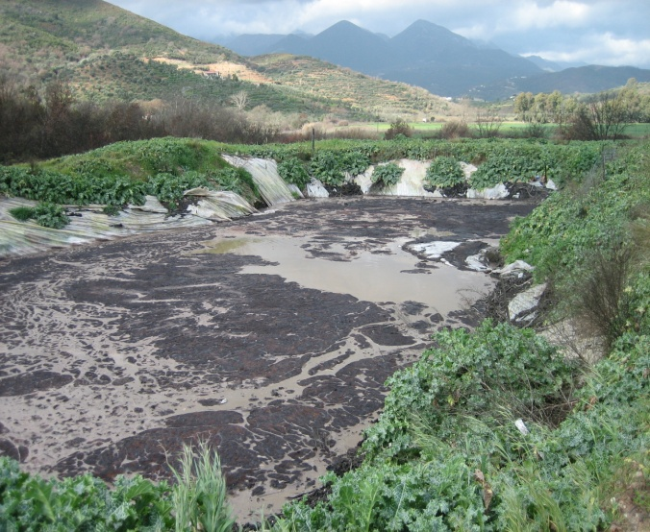
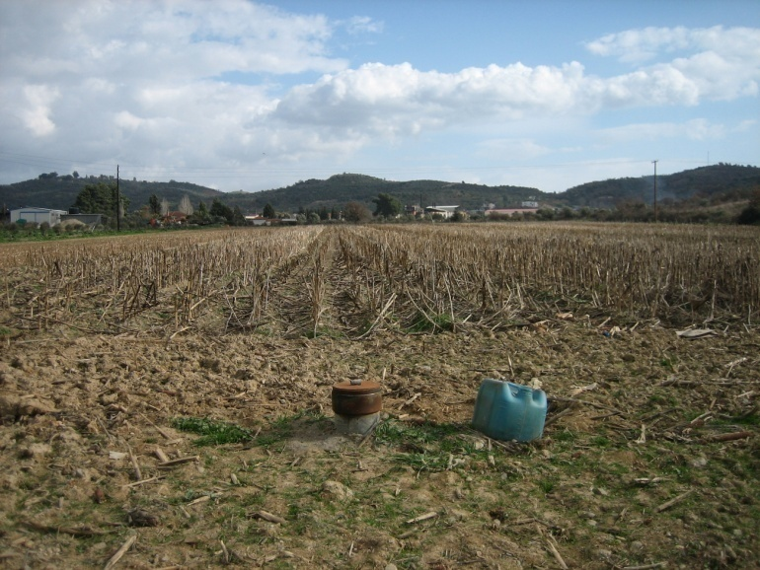
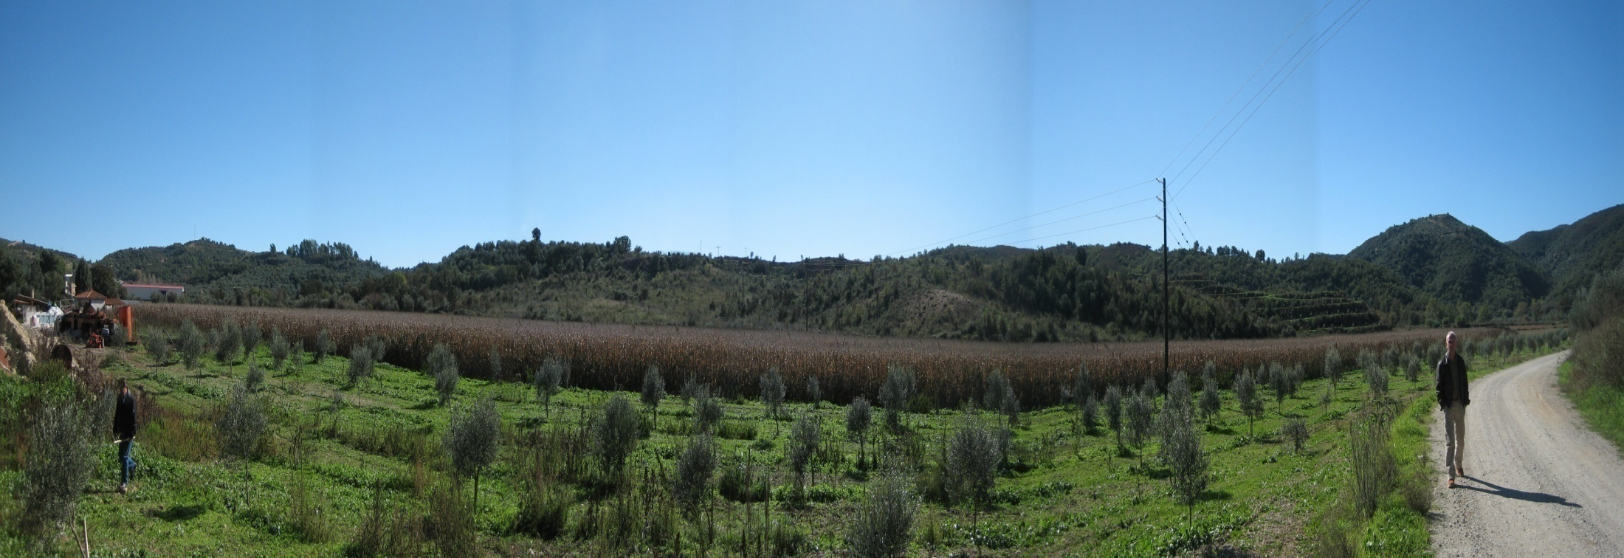
Irrigation/Fertilization with Olive Mill Waste Water

Slide 43
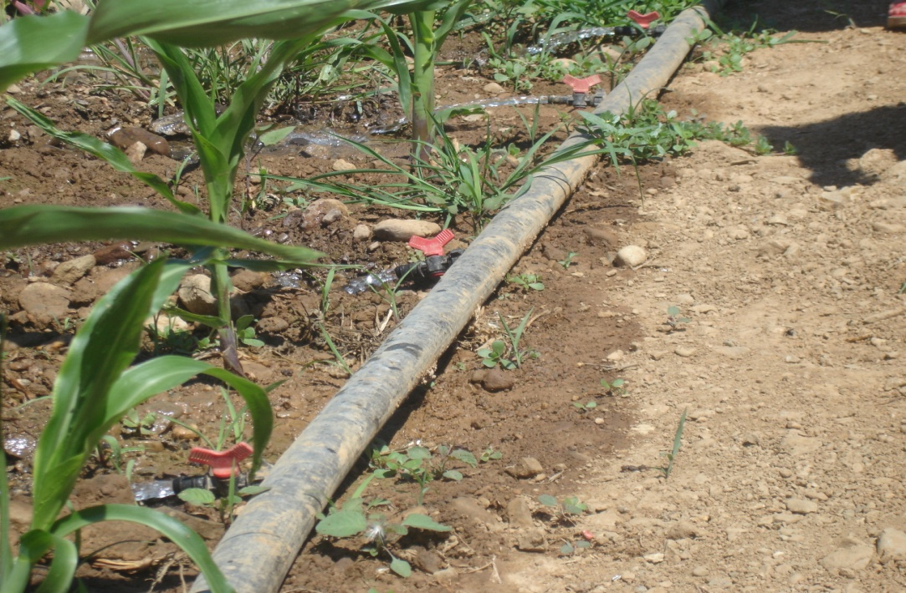
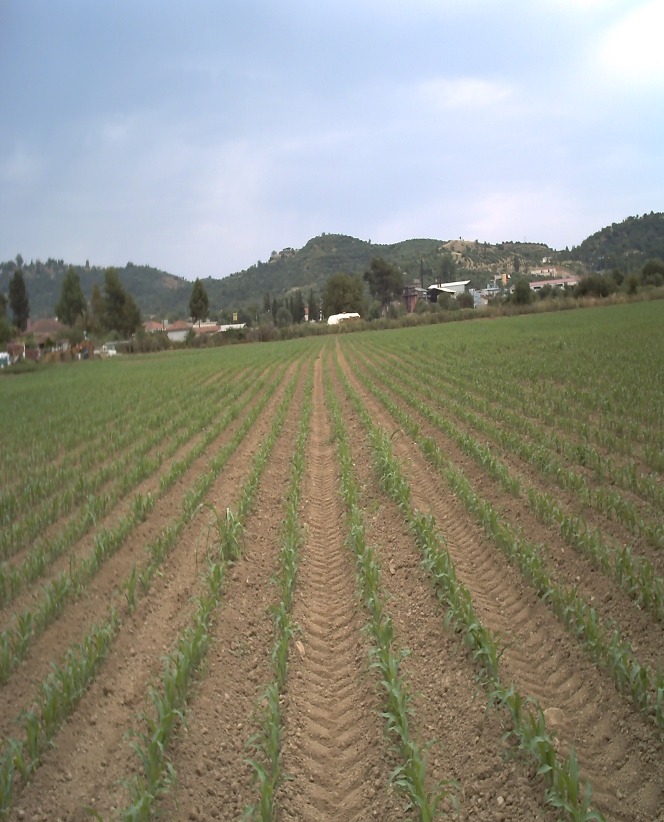
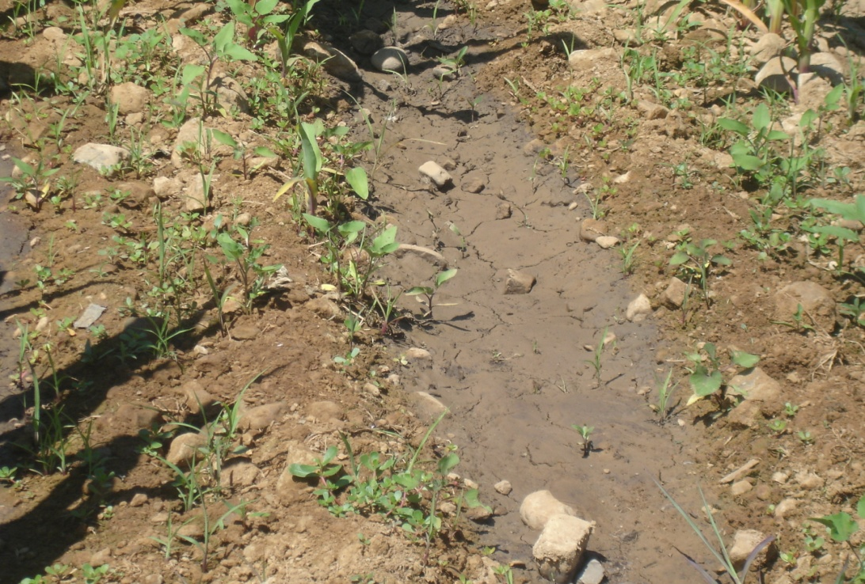

Slide 44
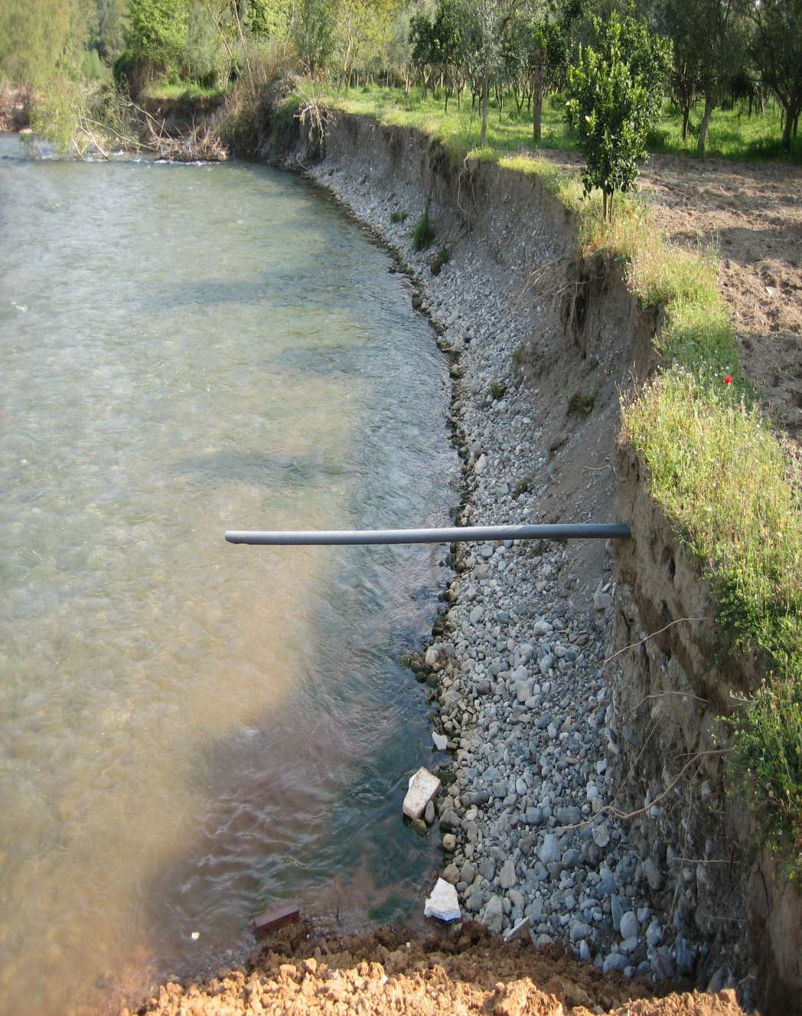
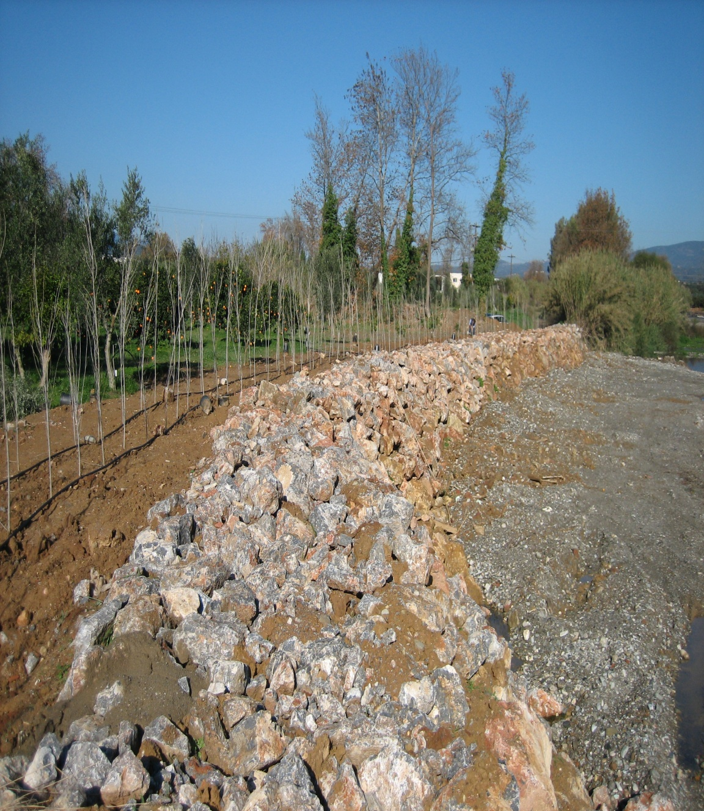
Riparian Zone Restoration

Slide 45
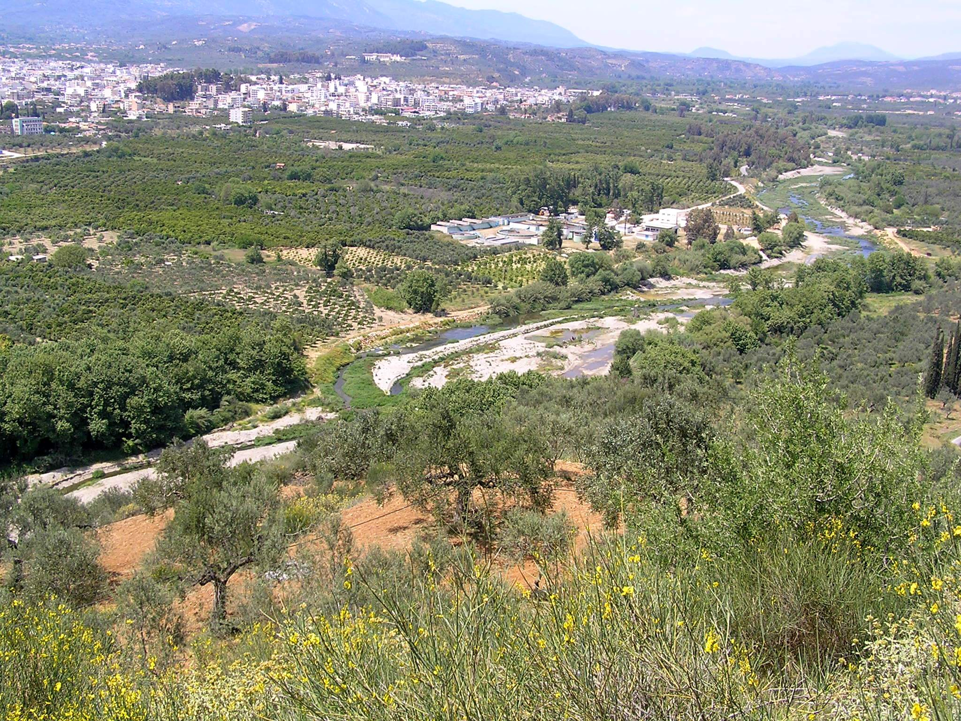
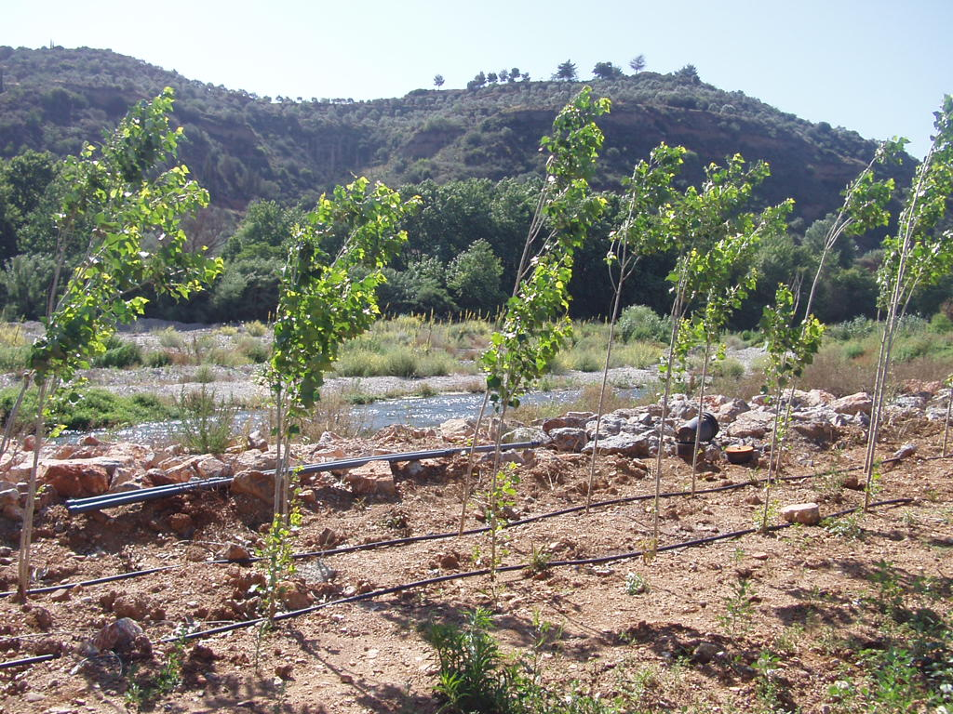

Slide 46


Drainage Canal Management

Slide 47

Bank Erosion Protection

Slide 48
Stakeholder Involvement/Education

Slide 49

PoM Priorities
Reduction in irrigation water use
Treatment/reuse of point sources (OMWW and OJWW)
Elimination of waste water disposal
Riparian Zone Restoration

Slide 50


Slide 51

How do you “build community”?
How do you build water governance institutions?
How do you change attitudes and cultural habits?
How do you manage sustainably water and soil resources?

Slide 52

Thank you Ευχαριστώ Gracie Mille Muchas Gracias

