Slide 1

Lecture 1- Global Environmental Challenges, Managing Water and Soil Resources and Observatory Science (The Koiliaris Critical Zone Observatory Case Study)
Nikolaos P. Nikolaidis
School of Environmental Engineering, Technical University of Crete, Chania, Greece
Integrated Water Resources Management – Graduate Course

Slide 2
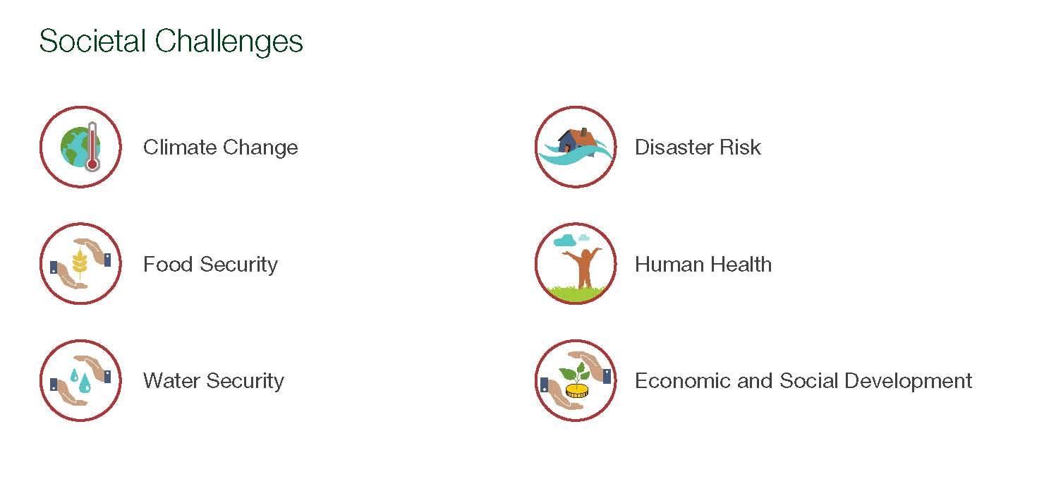
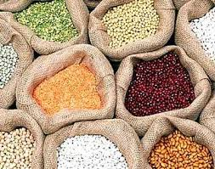
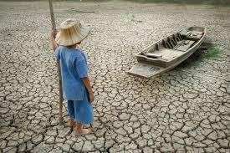
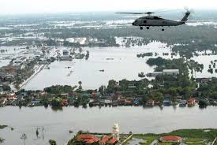
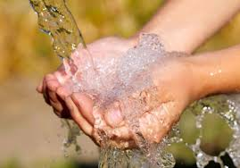
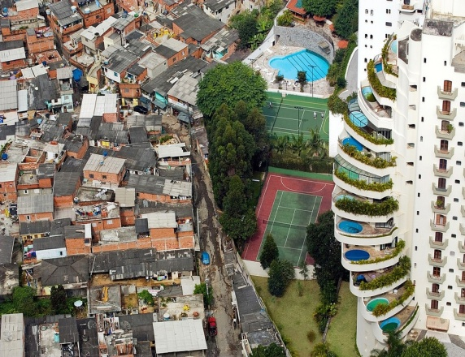
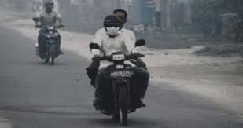
Grand Societal Challenges

Slide 3

The Perfect Storm
Energy
Increased demand 50% by 2050 (IEA)
a perfect storm of converging challenges within the next 40 years.
population to over 9.3 billion by 2050
Quadrupling in the global economy
Doubling in demand for food and for fuel
More than 50% increase in demand for clean water
… all while mitigating and adapting to the impacts of global climate change.
Soil ecosystem services are essential and under threat
Body Text
Climate change
Food
Increased demand 50% by 2050 (FAO)
Water
Increased demand 50% by 2050 (IFPRI)

Slide 4
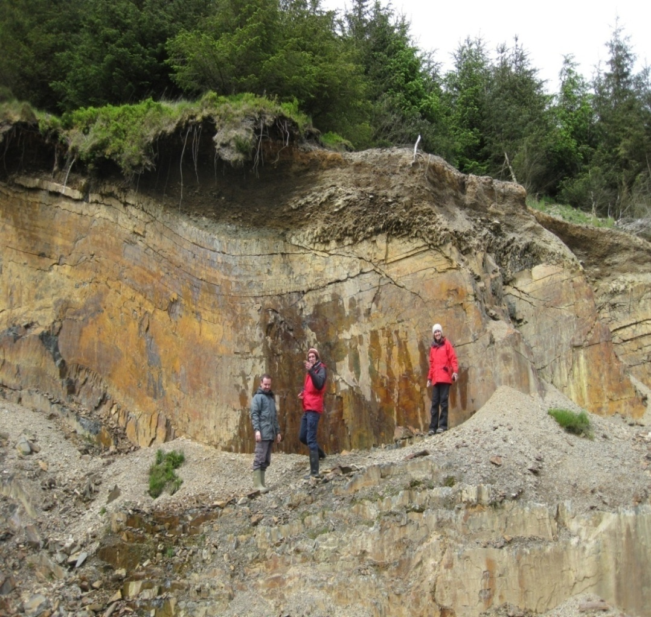
The Critical Zone: Treetop to Bedrock
Soil Ecosystem Functions:
Food and biomass production
Biodiversity
Carbon sequestration
Water filtration and transformation
Raw material
Landscape and heritage
Soil ecosystem functions are derived from the dynamic actions of plant, animal and microorganism communities and the non-living environment interacting as a unit.
Humans have not integrated themselves in the soil ecosystem, but depended on its services for sustenance.

Slide 5

Structure of talk…
Soil degradation - Historical amnesia
Soil ecosystem shift and tipping points: Are they real?
Towards restoring soil functions – Modeling soil functions

Slide 6
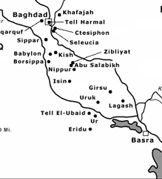
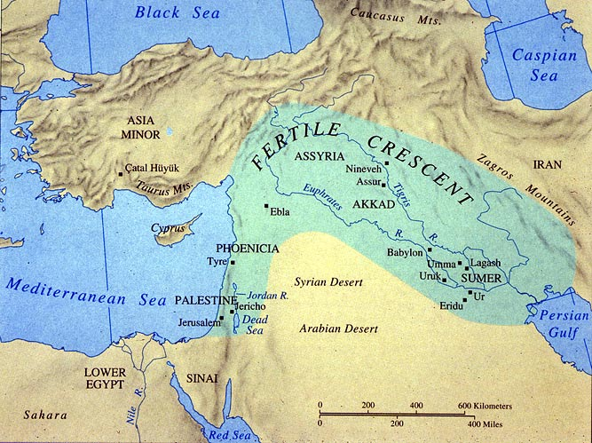
Land Degradation 5000 years ago
Mesopotamia 2000 BC
Notes:
(for example the Sumerians, the Akkadian dynasty, and the Babylonian and Assyrian empires)
Most importantly, as Jared Diamond shows in Guns, Germs, and Steel, the Fertile Crescent possessed the wild progenitors of the eight Neolithic founder crops important in early agriculture (i.e. wild progenitors to emmer wheat, einkorn, barley, flax, chick pea, pea, lentil, bitter vetch), and four of the five most important species of domesticated animals — cows, goats, sheep, and pigs — and the fifth species, the horse, lived nearby. this area is most famous for its sites related to the origins of agriculture. The western zone around the Jordan and upper Euphrates rivers gave rise to the first known Neolithic farming settlements (referred to as Pre-Pottery Neolithic A (PPNA)), which date to around 9,000 BCE (and includes sites such as Jericho). This region, alongside Mesopotamia (which lies to the east of the Fertile Crescent, between the rivers Tigris and Euphrates), also saw the emergence of early complex societies during the succeeding Bronze Age. There is also early evidence from this region for writing, and the formation of state-level societies. This has earned the region the nickname "The Cradle of Civilization."
The rich Mesopotamian marshlands known for centuries as the Fertile Crescent have almost completely disappeared, with only 10 percent of the important ecosystem still remaining, according to a study based on satellite images of the region.
Uruk represents one of the world's first cities with a dense population. Uruk also saw the rise of the state in Mesopotamia with a full-time bureaucracy, military, and stratified society. Cities that coexisted at this time with Uruk were only about 10 hectares in area showing that Uruk was significantly larger and more complex.
Uruk is an important city because it represents a shift from small, agricultural villages to a larger urban center. The city was located in the alluvial plain area of southern Mesopotamia, on the Euphrates rivers. Through the domestication of native grains from the nearby Zagros foothills and extensive irrigation techniques, the area supported a vast variety of edible vegetation. This domestication of grain and its proximity to rivers enabled Uruk's growth into the largest Sumerian settlement, in both population and area, with relative ease.

Slide 7
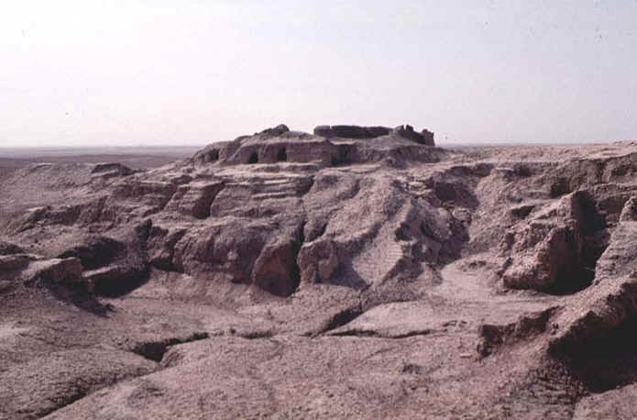
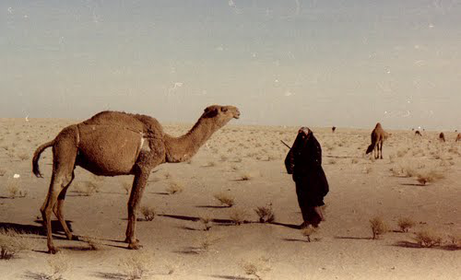
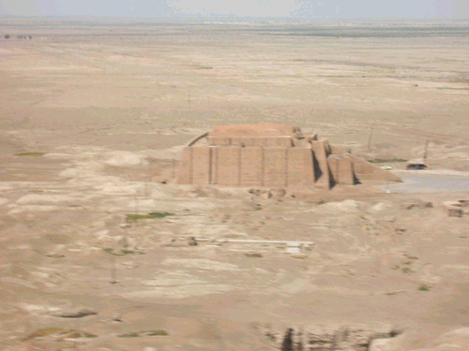
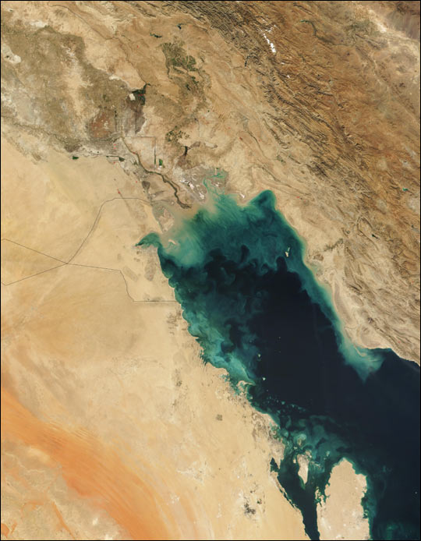
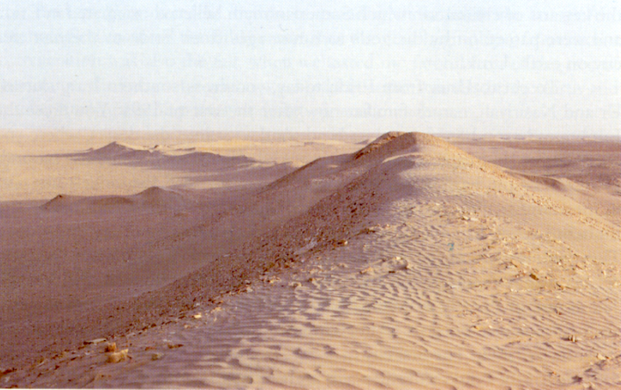
Soil Salinization
Shoreline 5000 years ago
SUMERIA
URUK
SUMERIA NOW
Persian Gulf sediments produced during 5000 years of soil erosion
aka Southern Iraq
Uruk today: Soil Salinization
Sediments from recent erosion
SEDIMENT FROM
NIPPUR
ERODING SOILS
NASA
Notes:
The earliest agricultural disaster story pertains to the earliest seat of sedentary agriculture, the Tigris-Euphrof increasing salinization of the soil, coupled with climatic cooling, there was a change from wheat to the more salt and cold tolerant barley, followed by the abandonment of extensive farming altogether in the lower reaches of the two rivers. The irrigators had also to contend with excessive sedimentary loads, which caused changes to the river channels and blocked irrigation canals. The excessive loads were themselves the result of forest clearances by the farming populations of the upper reaches of the river system.
Along with factors such as war and changes in the environment, scientists now believe irrigation techniques played an important role in Mashkan-shapir's collapse. The same process that allowed farming in this region also eventually made it impossible to farm. Irrigation has a Catch-22: if irrigation water is allowed to sit on the fields and evaporate, it leaves behind mineral salts
The famous citiesl of ancient Mesopotamia are now desolate mounds in a desert environment.
The Tigris-Euphrates area, site of the earliest civilization on earth, is also the site of the earliest agricultural disasters – mostly associated with salinization, but also associated with extensive soil erosion. More recently, Sadam Hussein’s drainage of the wetland in this region, has caused additional problems, not least to the Marsh Arabs who had managed to sustain their form of society for 5,000 years until Sadam.
A characteristic locality, which brings all the prerequisites together is a large river system,
draining an area where freshly exposed and lightly weathered geological materials provide
nutrient-rich sediment for distribution lower down the valley. Early civilizations in the valleys of the
Tigris and Euphrates, the Nile, Indus and Huang Ho, had this kind of physical basis. Because of
the association with rivers, they are often referred to as "hydraulic civilizations". Each appears to
have been preceded by a period of experimentation in nearby highland regions where rainfed
agriculture was practiced. 14 Some of the oldest known rainfed systems are found in southern
Turkey, through northern Syria and Iraq to the Zagros Mountains in the highland rim of the "Fertile
Crescent". After considerable trial and error, farming was introduced into the valleys of the Tigris
and Euphrates, where the earliest cities were built soon after 5000 B.C. Their support came from
the surplus of food that the farmers produced. All later civilizations, including our own, have a
similar foundation: the farmers' surplus is crucial. The necessity to manage river water for
irrigation of crops was probably a major factor in developing the kinds of cooperation and division
of labour necessary for a civilized existence.
When civilization spread out from the river valleys it diffused into areas where
atmospheric precipitation was reliable and irrigation unnecessary. The materials and processes of
surficial geology were of paramount importance. The diffusion of agriculture into Europe for
example, appears to have been brought about by the migration of farmers from the Middle East
moving at the rate of about 1 km per year. As Jared Diamond points out, it was helped b/ the fact
that latitudinal diffusion is made easy by the absence of north-south barriers. 1 Moving
domesticated crops in an essentially east-west direction minimizes the amount of climatic
variation the farmers must deal with in terms of their crop varieties
Hummurabi of Babylon (~1800 BCE)- 10,000 sq mi were in crops and around 15-20 million people inhabited the region. Today the region supports less than ¼ as many people as it did during Hummurabi.

Slide 8
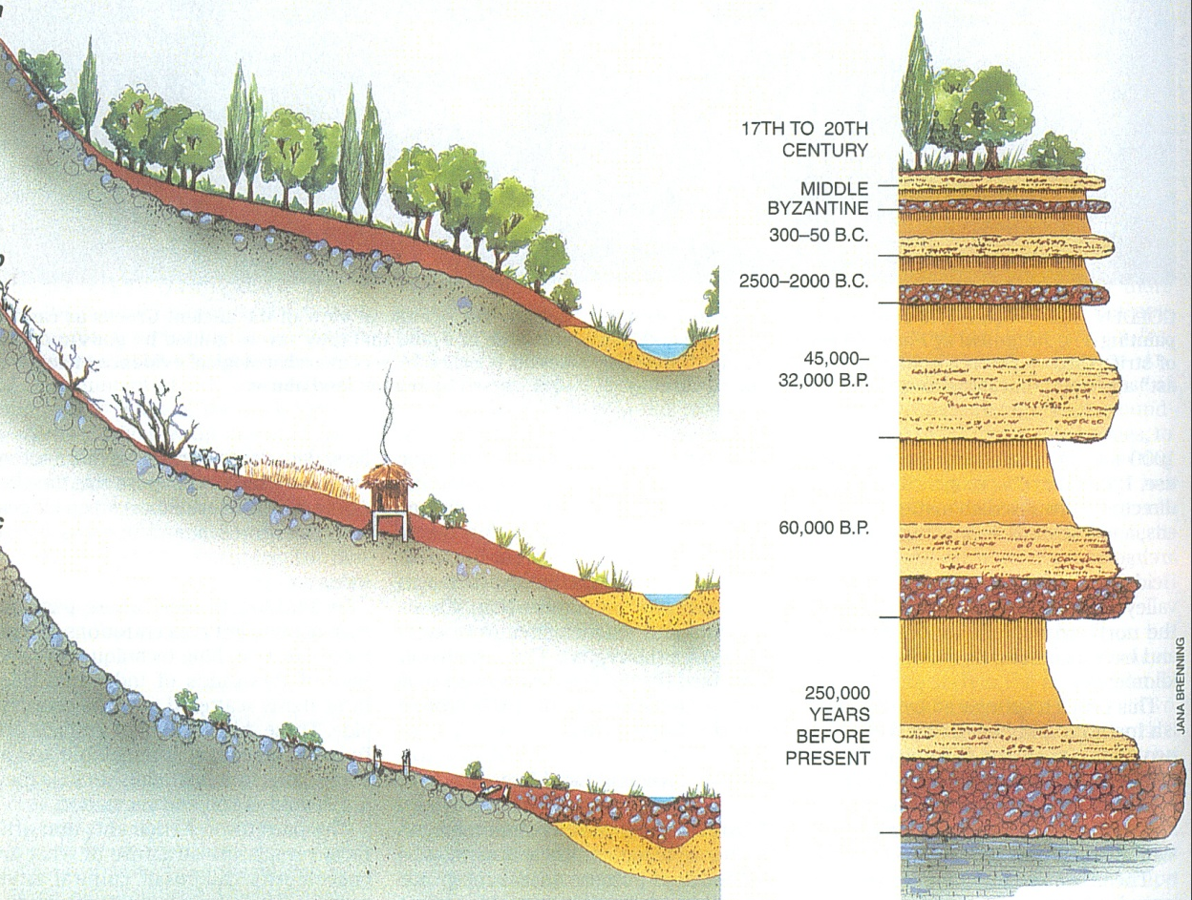
Environmental Degradation
in Ancient Greece (Argolida);
Runnels, Scientific American, 1995
Notes:
A typical geologic profile from southern Argolid region of Greece ( a remote part of the Peloponnese peninsula) shows a sequence of erosional deposits and intervening soils

Slide 9
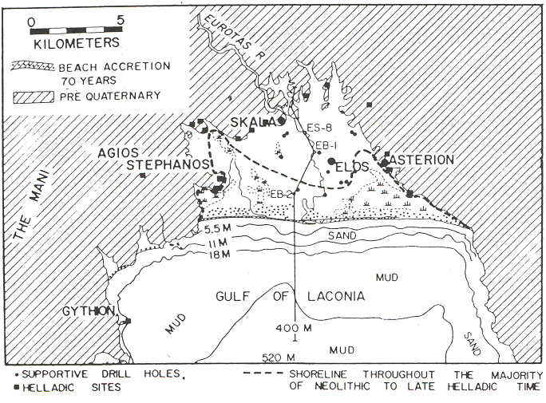
Lakonia shoreline 3000 years ago –
Elos the “Castle of the Sea”
Kraft et al., 1977, Science 195: 941-947

Slide 10
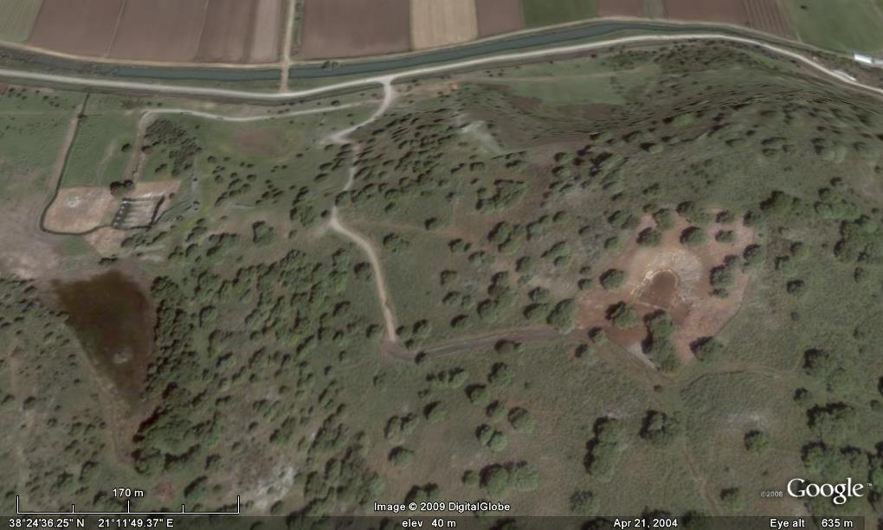
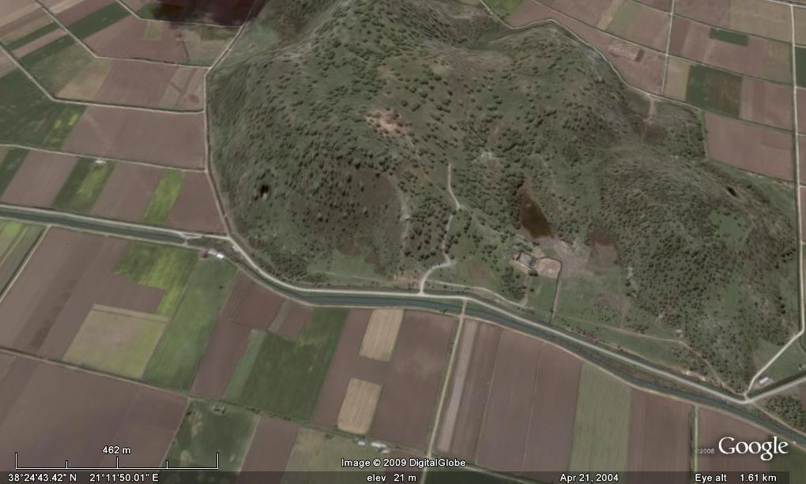
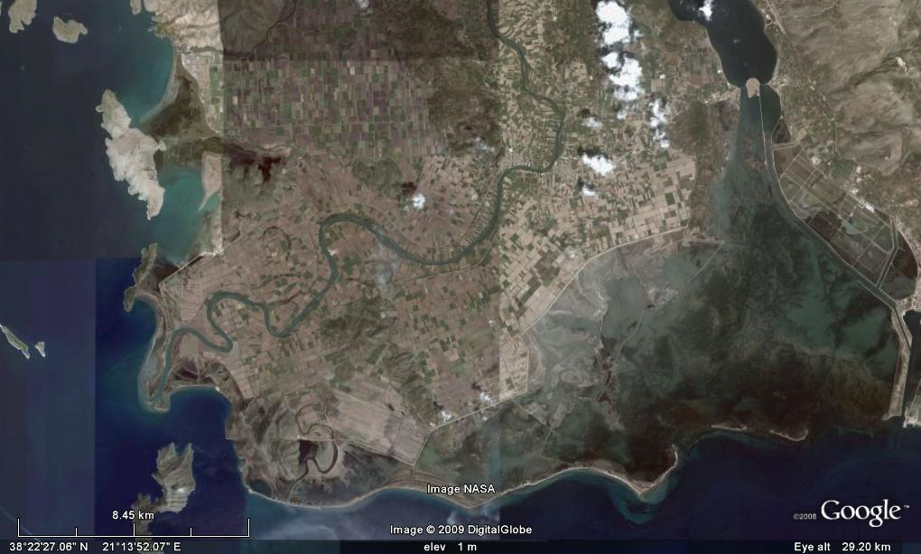
Acheloos River Delta

Slide 11
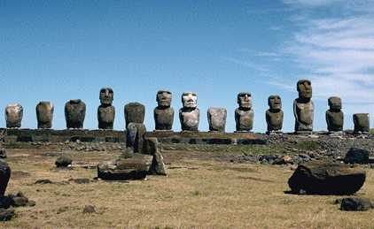
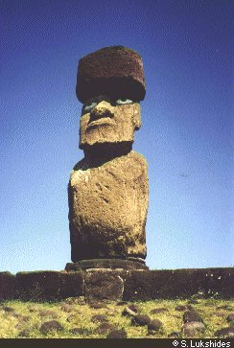
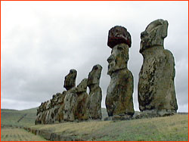
Easter Islands
Ecological Disaster and the Rapa Mui

Slide 12
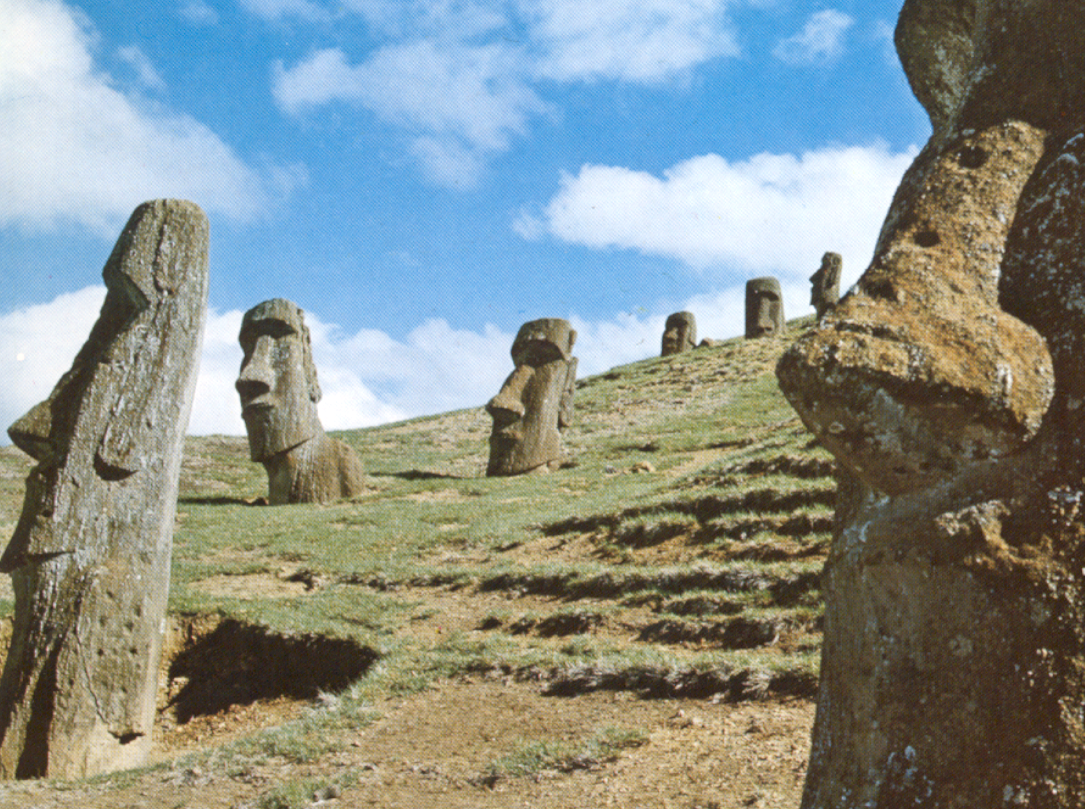
“The reaction of land
to occupancy determines
the nature and duration
of civilization”
Aldo Leopold:
The Conservation Ethic 1933
Notes:
Darwin’s trap

Slide 13
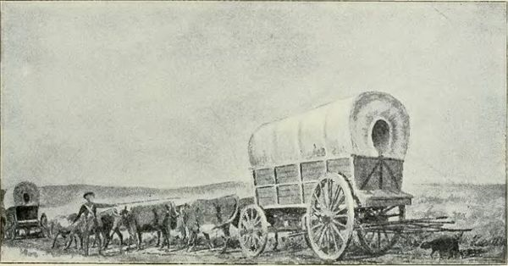

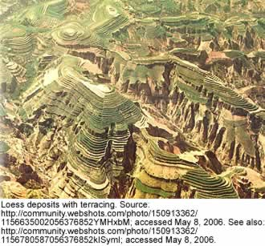
Historical Amnesia
Land Degradation the Past 100 years
Dust Bowl – The Virgin Land Project – The Loess Plateau

Slide 14
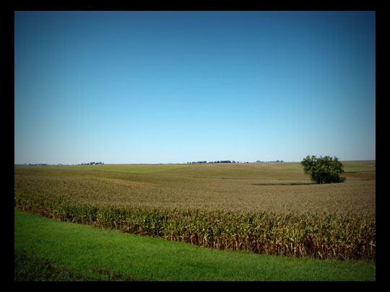
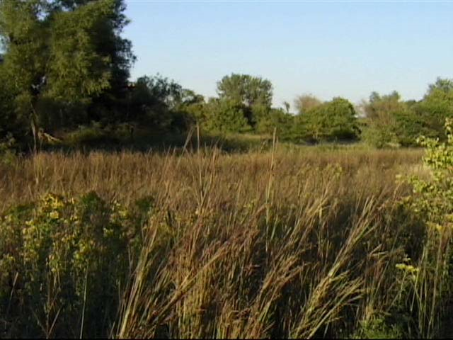
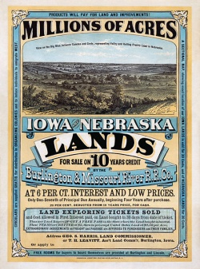
The Dust Bowl

Slide 15
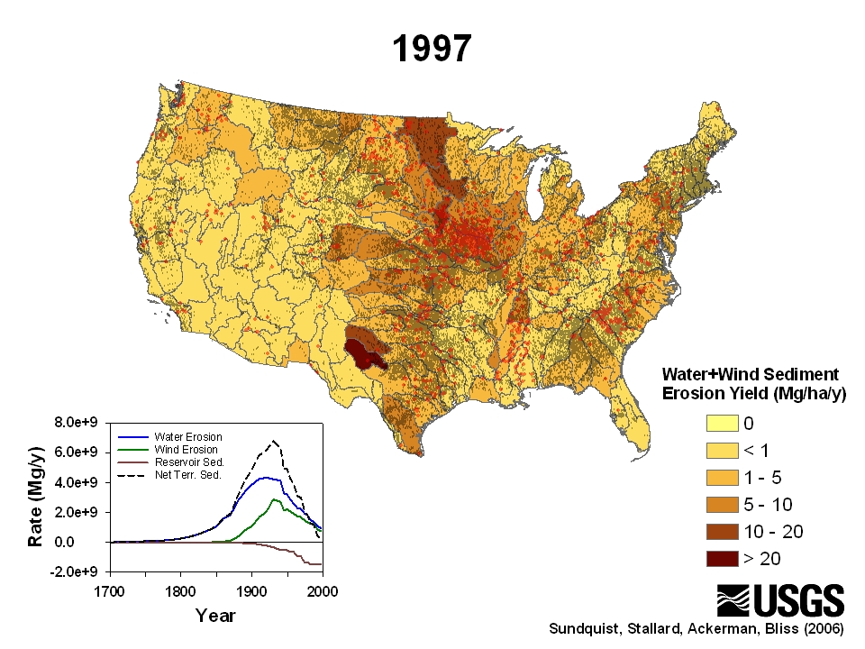

Slide 16
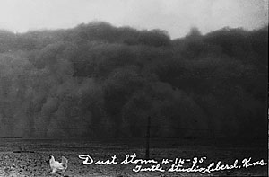
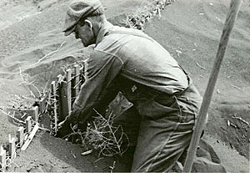
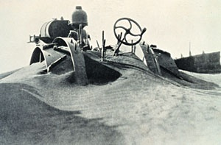
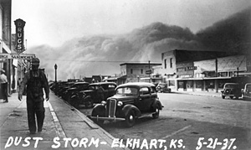
The Dust Bowl – USA: 3 million people affected

Slide 17
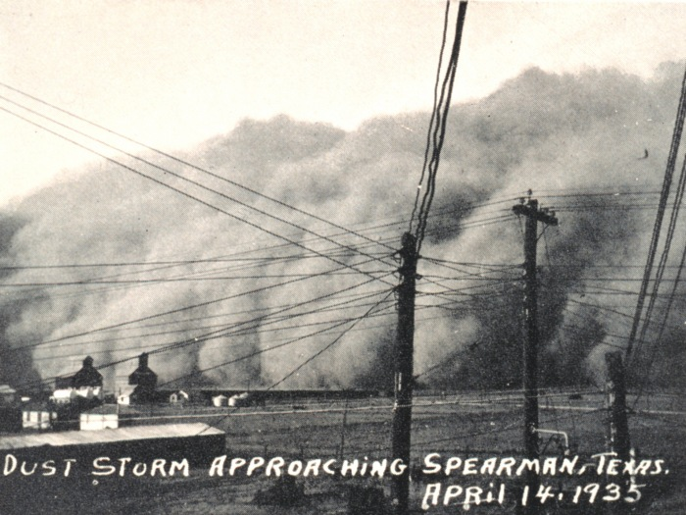
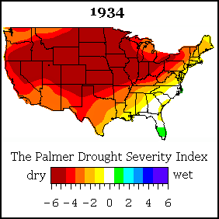
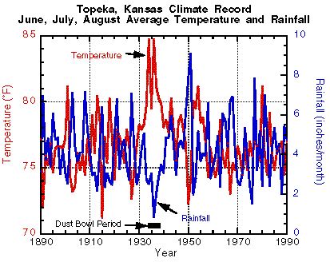
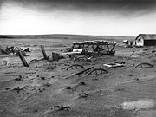
Notes:
Farmers throughout the Great Plains had converted native grasslands to wheat fields after a series of wetter-than-average years and bountiful harvests in the late 1920s.
An estimated 12 centimeters (5 inches) of topsoil were lost from 4 million hectares within the Dust Bowl region (total area was 24 million hectares) when the rains failed. The effects of the Great Depression exaggerated the cultural impact of the Dust Bowl.
The Palmer Drought Index (PDI) maps show long-term (cumulative) meteorological drought and wet conditions. The animated maps to the left show how the geographical pattern of the long-term (meteorological) moisture conditions has changed over the last 12 months. On these maps, the red shading denotes drought conditions while the green shading indicates wet conditions.
The Palmer Drought Severity Index (PDSI) (known operationally as the Palmer Drought Index (PDI)) attempts to measure the duration and intensity of the long-term drought-inducing circulation patterns. Long-term drought is cumulative, so the intensity of drought during the current month is dependent on the current weather patterns plus the cumulative patterns of previous months. Since weather patterns can change almost literally overnight from a long-term drought pattern to a long-term wet pattern, the PDSI (PDI) can respond fairly rapidly.
The Dust Bowl exodus was the largest migration in American history. By 1940, 2.5 million people had moved out of the Plains states; of those, 200,000 moved to California.[11] With their land barren and homes seized in foreclosure, many farm families were forced to leave. Migrants left farms in Kansas, Texas, and New Mexico, but all were generally referred to as "Okies". The plight of Dust Bowl migrants became widely known from the novel The Grapes of Wrath by John Steinbeck

Slide 18

New York Stock Exchange: 1920-1940
1932
1929
1937

Slide 19
The Virgin Land Project:
Steps leading to an ecosystem collapse
Land use change: World’s largest land conversion projects. 42 million hectares of land located between the lower Volga River, Northern Caucasus Mountains and Eastern Siberia were ploughed for grain.
Soil impacts: The Virgin Land Project was initiated in 1954. Intensive agricultural practices caused soil degradation and decrease in soil fertility and the first year’s high yield was never obtained again.
Water impacts: The reclamation project was accompanied by several canal irrigation projects that diverted the water of Syr Darya and Amu Darya Rivers for irrigation mainly of cotton fields.
Ecosystem crisis: The Aral Sea ecosystem catastrophe.
Notes:
Land use change: The Virgin Land Project was carried out during the former USSR and constituted the world’s largest land conversion projects. In total, 42 million hectares of land located between the lower Volga River, Northern Caucasus Mountains and Eastern Siberia were ploughed for grain. The area was a fragile dry-land ecosystem (annual precipitation of 300-400 mm) that historically, was cultivated intermittently.
Soil impacts: The Virgin Land Project was initiated in 1954 and the first year yield was considered excellent amounting to 13.9 and 15 quintals grain/ha. Intensive agricultural practices caused soil degradation and decrease in soil fertility and the first year’s high yield was never obtained again. In fact, in one of the reclaimed regions, the Tselinnyi Krai which is considered the world’s largest monoculture region, the yield in 1954 was 9 quintals grain/ha and by 1963 had fallen to 3.
Water impacts: The reclamation project was accompanied by several canal irrigation projects that diverted the water of Syr Darya and Amu Darya Rivers (main tributaries to Aral Sea) for irrigation mainly of cotton fields. Inefficient use of irrigation water (ie open canals in a desert-like environment) resulted in an annual use of water for irrigation of 20-50 billion m3 which decreased the inflow stream water to Aral Sea.
Ecosystem crisis: The water level in Aral Sea was dropping 20 cm/yr during the 60s, 60 cm/yr during the 70s and 1 m/yr in the 80s resulting in the largest ecosystem catastrophe to date (the Aral sea has shrunk up to 60% from original measurements).

Slide 20
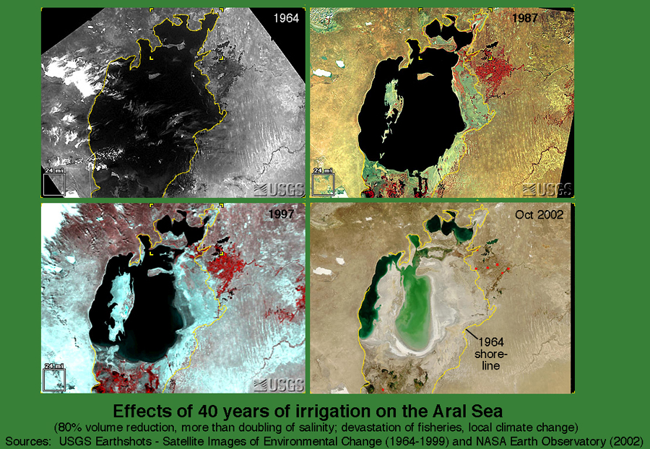

Slide 21
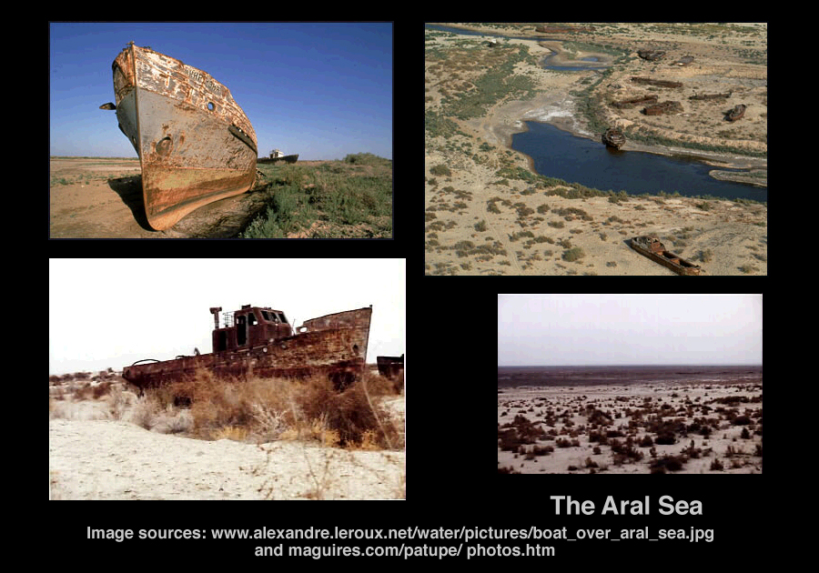

Slide 22
Soil degradation - Historical amnesia
Soil ecosystem shift and tipping points: Are they real?
Towards restoring soil functions – Modeling soil functions

Slide 23
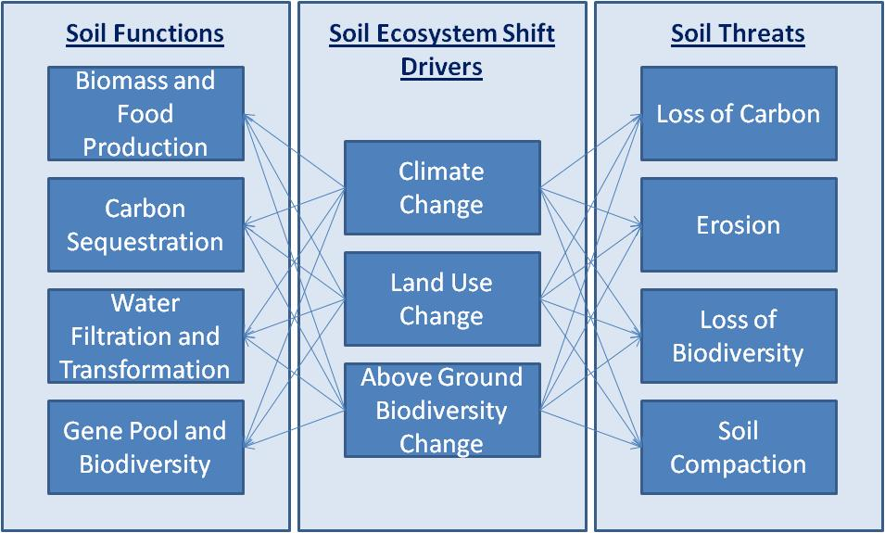
Soil Ecosystem Shifts and Tipping Points: Are they real?
Soil ecosystem shifts are abrupt changes that have long-lasting effects on the landscape and both the biotic and abiotic structure of the soil.
The point in time when the ecosystem shifts from one state to another is called “tipping point.”
The 4th driver is fertilization.

Slide 24
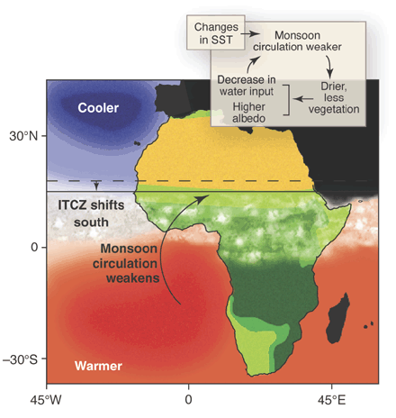
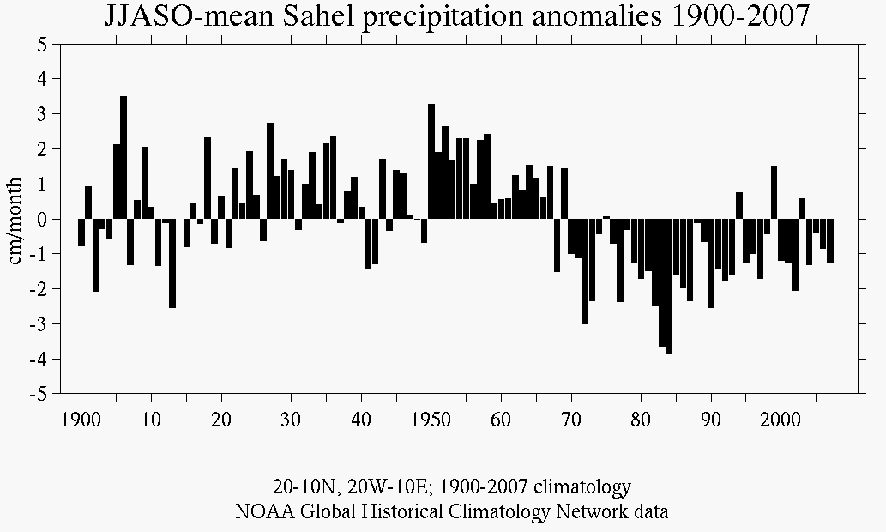
Sahel and Climate Change Soil Ecosystem Shift and Tipping Point
Drought of 1968
(Zeng 2003)
Notes:
Recent work by meteorologists and oceanographers has shown that much of the recent year-to-year changes in Sahel rainfall are forced by changes in sea-surface temperature in the Gulf of Guinea (on the equator near the prime meridian) and by El Niño in the Pacific. When the gulf is warm, the Intertropical Convergence Zone shifts south away from the Sahel reducing the African monsoon that draws moist air into the Sahel. Longer term changes in rainfall from decade to decade are forced by changes in sea-surface temperature in the western Indian and tropical Atlantic oceans. When these areas are cool, Sahel rainfall increases.
The oceanic forcing of Sahel rainfall is amplified by land-atmosphere feedbacks. As the land dries out, there is less vegetation, less evaporation from the land, and more sunlight is reflected from the land. These processes further weaken the monsoon. This positive feedback also involves land degradation due to human interactions with the land.
1. Population increase. Population is doubling every 20 years. The growth rate of population (3% per year) exceeds the growth rate of food production (2% per year). The total population is around 260,000,000 people.
2. Poverty. Per capita income varies from $500/year in Burkina Faso to $1,000/year in Mali to $2,000/year in Nigeria
3. Over grazing, poor farming methods, and use of trees and vegetation for firewood. Overgrazing and poor agricultural practices lead to soil erosion, further degrading the land.
The traditional Parkland system (integrated crop-tree-livestock systems), which is the predominant land use system and the main provider of food, nutrition, income, and environmental services, is rapidly degrading—woody biodiversity and cover is being lost, and soil fertility is declining from already low levels through exhaustive cropping practices and soil erosion.

Slide 25
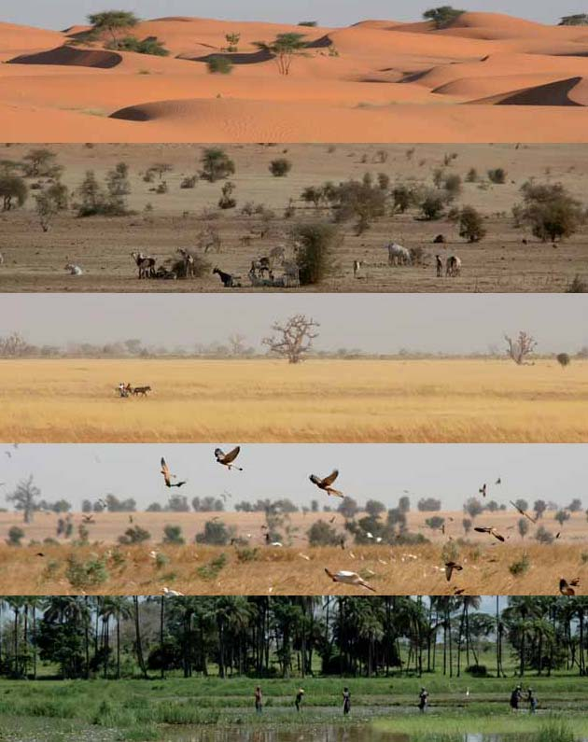
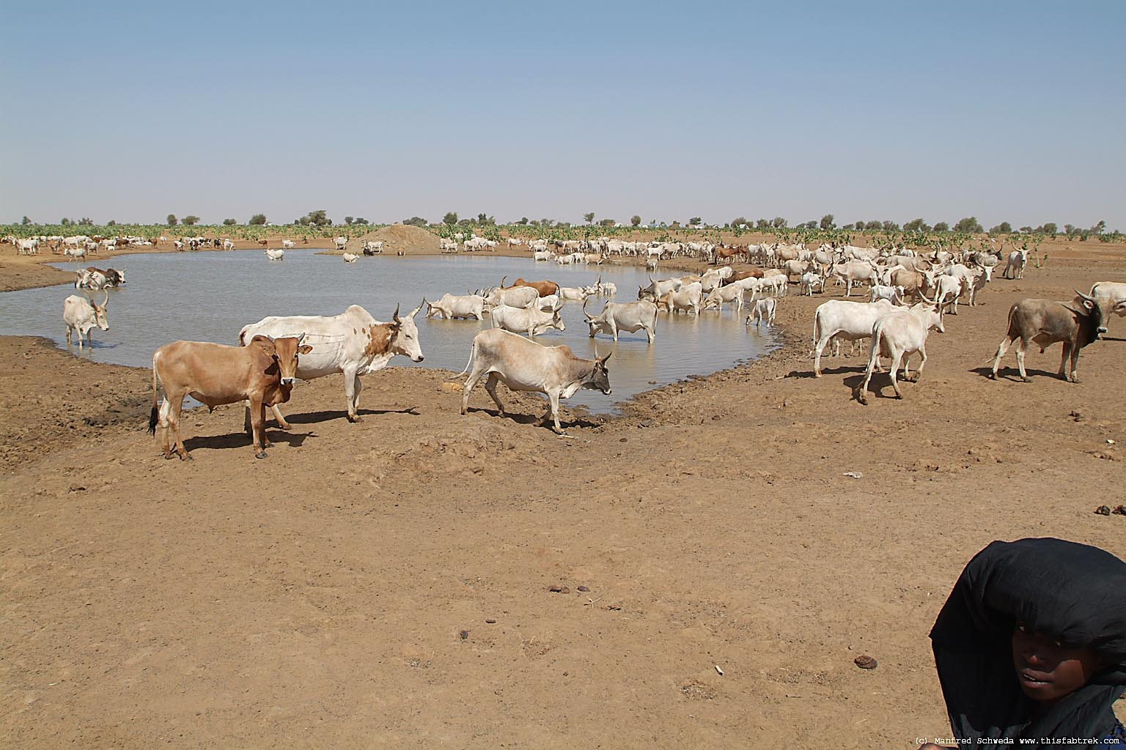
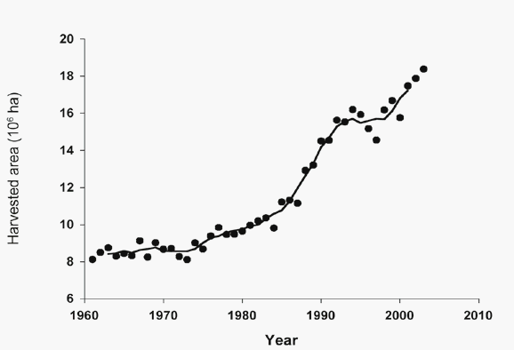
Living on the Edge in the Sahel -Transition from Desert to Green and Lush
A few hundred Km
(Zwarts et al., 2009)

Slide 26
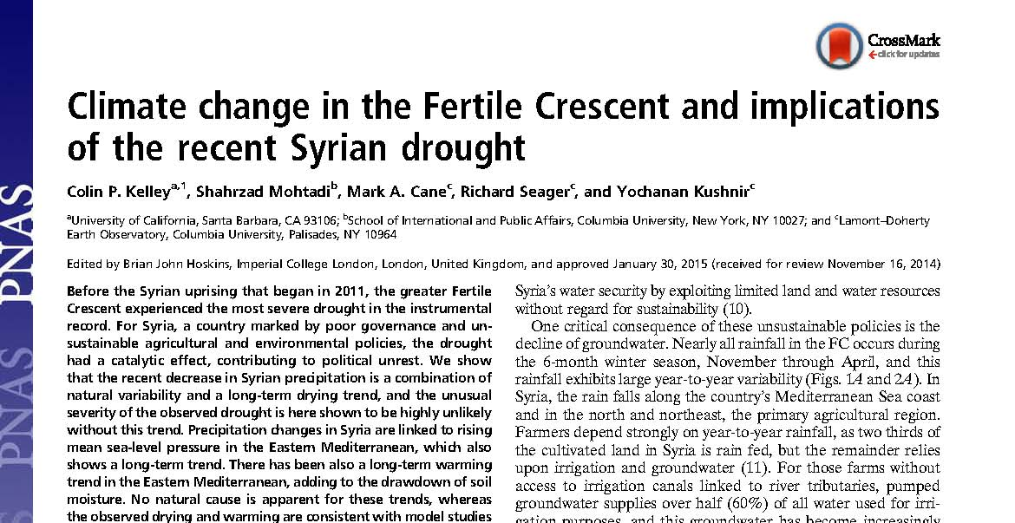
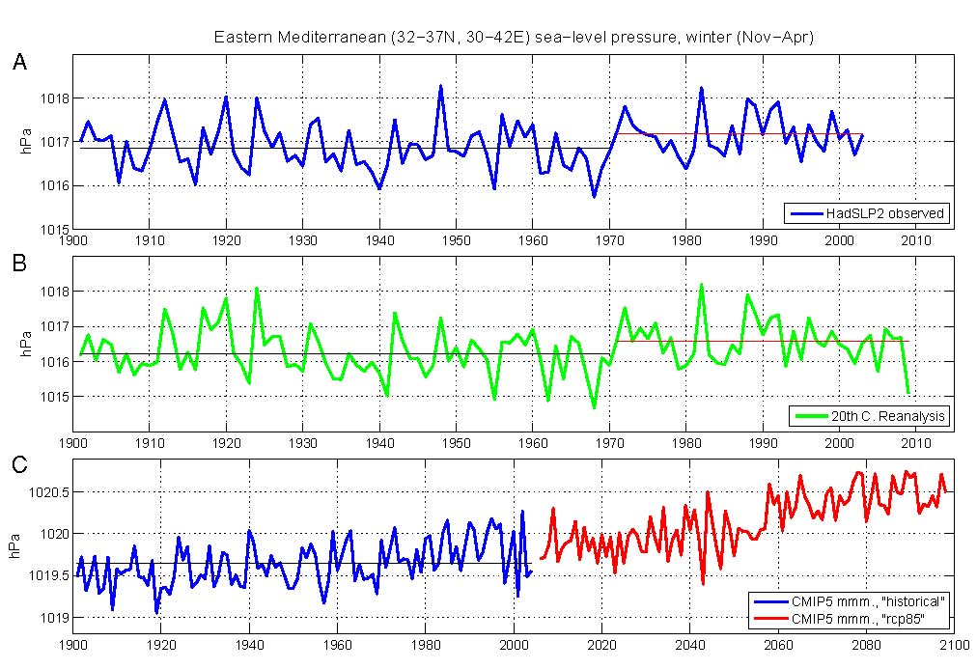
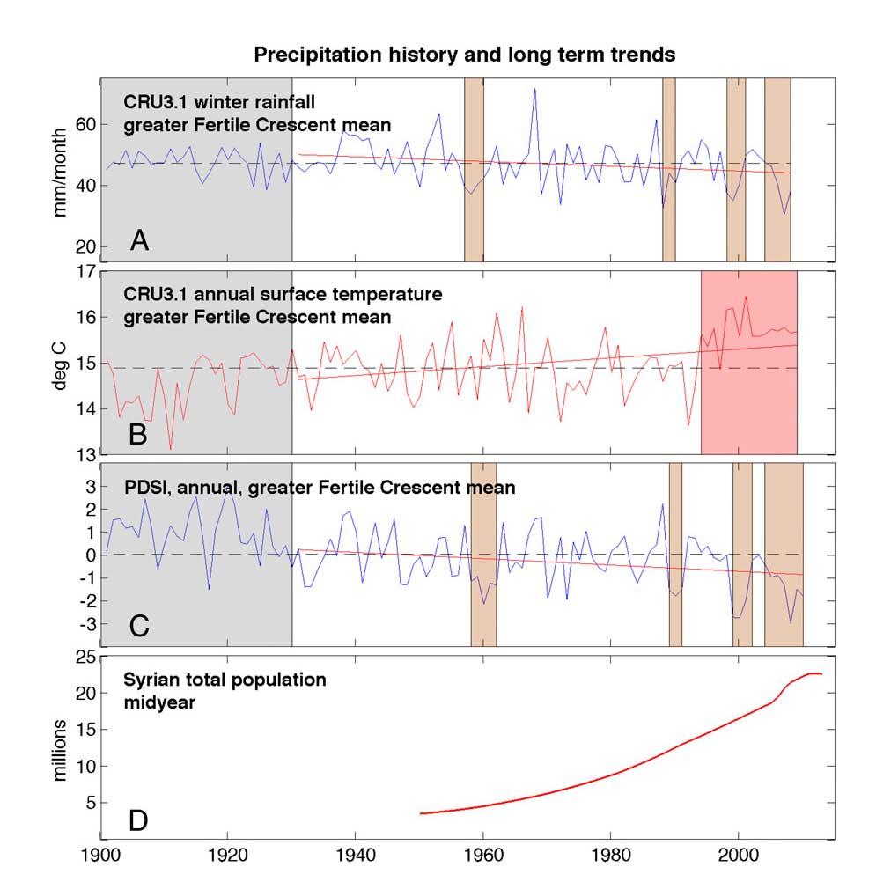
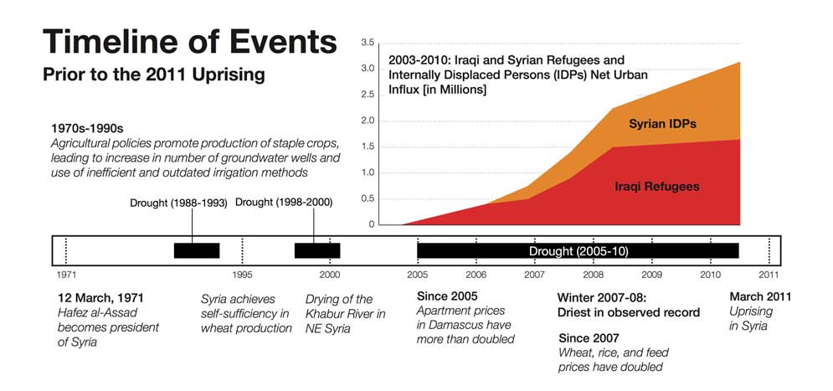

Climate Change ➔ Higher sea level pressure ➔ multi-year droughts ➔ urbanization
Fertile crescent climate anomaly

Slide 27

Ecosystem Collapse

Slide 28

Self organized patchiness and vegetation positive interactions
Arid Ecosystems
Savanna Ecosystems
(Rietkerk et al., 2004 SCIENCE)

Slide 29

Livestock Grazing Impacts and Tipping Points
Increasing grazing pressure→ Decreasing Local Positive Interaction
Patch size distribution maybe a warning signal for the onset of desertification
(Kefi et al., 2007 NATURE)

Slide 30


Livestock Grazing Impacts and Tipping Points
Resilience of Soil Productivity to Stocking Density – Model Results
Mesic Mediterranean
Typical Mediterranean
Dry Mediterranean
Semi-arid
Arid
(Kochy et al., 2008)

Slide 31








Changes in Agri-practices....
Soil Threats
Loss of carbon and nutrients
Loss of biodiversity
Erosion
Compaction
Contamination
Salinization
Floods and Landslides
Sealing
Agri-practices....
Compaction N and P fertilizers Irrigation
Reduction in production – loss of soil fertility
We are loosing soil 100 times faster than we can make it
Unsustainable soil practices – expensive – reduced production
Pesticides Erosion Fires

Slide 32


SOC and STN decline after conversion of a Forest (F) or Grassland (G) to cropland (C)

Slide 33




Erosion….
Oversized machinery….

Slide 34




Erosion…
Tilling the olive groves…

Slide 35

Soil Compaction: Impacts from tilling
Papanikolaou et al., 2007

Slide 36



Fertilizer are not cheap….
Daily recommended dose of P 1,2 g/ca/d or 0,438 kg P-rock/yr
We consume 22,5 kg P-rock/ca/yr
…and wasteful - We use 50X more P than we need

Slide 37
What is wrong with modern agricultural production?
Consumed vs Produced Energy
      Lamb meat 57/1
      Cow meat 40/1
      Pork meat 14/1
      Milk 14/1
      Turkey 10/1
      Chicken 4/1
      Produce 7-10/1
      Corn 1/4
Source: Tables 2 and 4 from Sustainability of Meat-Based and Plant-Based Diets and the Environment by D. Pimentel and M. Pimental in J. of Amer. Clinical Nutrition, 78(suppl) p. 660S–663S.

Slide 38

Soil degradation
Notes:
Soil degradation is an important environmental issue in this century because of its adverse impact on agronomic productivity, environment, food security, and quality of life. It has a direct impact on biomass productivity, water quality, and greenhouse gas emissions into the atmosphere.
Water erosion represents 53 % of all soil degradation according to the World map of soil degradation

Slide 39
Soil degradation - Historical amnesia
Soil ecosystem shift and tipping points: Are they real?
Towards restoring soil functions – Modeling soil unctions

Slide 40

Aristotle “De Anima”
Plants are:
Low-level organisms
On the edge between living and not living.
They have a very low-level soul, “vegetative soul” because they lack movement and they don't need to sense.

Slide 41



NaNO3 – Nitrates - Quarries in Chile in 1840
Justus von Liebig (1803-1873)
«Plant fertilization-limiting nutrient»
(NH4)SO4 -Ammonia – Biproduct of gas from coal and iron mining – Plant in Ohio

Slide 42



Charles Darwin (1809-1882)
"The Power of Movement in Plants"
Darwin, the worms and the soil

Slide 43





The digestive system of the plants

Slide 44


Fungi – Plant
Interactions and Signaling
Ectomycorrhizal Fungi – Plant Interaction
Courty et al., 2010 SBB
Arbuscular Mycorrhizal Fungi – Plant Signaling
Bonfante and Genre, 2010 NATURE

Slide 45



Plant Growth Promoting Bacteria
Weyens et al., 2009 Trends in Biotechnology

Slide 46





Plant – Insect Communication – Biochemical Language
Spider Mite
Predatory Mite

Slide 47

Soil functions represented as flows and transformations of mass, energy and biodiversity within Earth’s critical zone.
Soil connections within the critical zone are illustrated by mass fluxes (arrows) across conceptualised horizontal flux planes at the interfaces
vegetation - atmosphere,
land surface - atmosphere,
lower soil profile and vadose zone/water table, - unaltered bedrock

Slide 48

Koiliaris Critical Zone Observatory

Slide 49


Watershed
Coastal Zone

Slide 50



Global ILTER site network
827 Παρατηρητήρια - ILTER

Slide 51

Δίκτυο LTER - Greece

Slide 52





Slide 53

Desertification Potential (National Council Against Desertification)
Desertification Potential
Low
Average due to erosion
High due to erosion
High due to salinization
Lakes
Town

Slide 54


Desertification=f(water deficit, land use practices)
PRECIPITATION
PET

Slide 55


SQI = (texture * parent material * rock fragment * depth * slope * drainage)^{1/6}

Slide 56
47 % free grazing
52 % domestic
Crete
601,130 population
3,820,673 livestock
Average stocking density=227
Koiliaris River:
586 goat&sheep /km²

Slide 57






1961 → 2 animals/ha 2001 → 7 animals/ha

Slide 58

Land use

Slide 59



39% Cultivated
55% Pasture and Forest

Slide 60



The Land of Crete…then
Oak, Pine and Cypress Forests
Olive groves, Vines, Cereal and Fruits
Pastoralism, agriculture and hunting since Neolithic times
Notes:
Αργυρή δραχμή Πραισού, 400 – 200 π.X., με το Δία σε θρόνο και την αίγα(γρο) Αμάλθεια που θήλαζε το Δία.
Σύμφωνα με τον Ησίοδο ο Δίας, ο πατέρας των θεών και των ανθρώπων του Ολυμπιακού Πανθέου, ήταν γιος του Κρόνου και της Ρέας, οι οποίοι είχαν γονείς τη Γη και τον Ουρανό. Ο Κρόνος, ο πατέρας του Δία, έτρωγε όλα τα παιδιά του μόλις γεννιόνταν, επειδή οι γονείς του του είχαν πει ότι είναι πεπρωμένο μια μέρα κάποιο από τα παιδιά του να του πάρει τη βασιλεία. Η Ρέα, η μητέρα του Δία, όταν επρόκειτο να γεννήσει το Δία, παρεκάλεσε τους γονείς της, τη Γη και τον Ουρανό, να καταστρώσουν κάποιο σχέδιο με το οποίο θα μπορούσε να διαφύγει κάπου μακριά, όταν θα γεννούσε το Δία, για να τον γλιτώσει από του Κρόνου τα δόντια. Αυτοί υπάκουσαν και την έστειλαν μια νύκτα με βαθύ σκοτάδι στην πόλη Λύκτο της Κρήτης και απ’ εκεί στο όρος «η Δίκτη» (ή το Δίκτον), όπου γέννησε κρυφά το Δία. Ωστόσο κάποια στιγμή έμαθε ο Κρόνος τα καθέκαστα και ήλθε και ζήτησε να δει το παιδί. Η Ρέα γνωρίζοντας τις προθέσεις του Κρόνου σπαργάνωσε ένα βράχο και τον έδωσε στον Κρόνο, ο οποίος αμέσως τον καταβρόχθισε, νομίζοντας ότι είναι ο Δίας και τον οποίο αργότερα ξέρασε στον Παρνασσό.
Σύμφωνα με τους άλλους αρχαίους συγγραφείς (ενδεικτικά): Απολλόδωρο, Διονύσιο Αλικαρνασσέα κλπ, όταν η θεά Ρέα γέννησε το Δία σε σπήλαιο της Δίκτης της Κρήτης, στο Δικταίο ‘Αντρο, επέστρεψε στον Όλυμπο, ώστε να μην πονηρευτεί κάτι ο Κρόνος με την απουσία της και για να μην πεθάνει ο νεογέννητος Δίας τον παρέδωσε να τον αναθρέψουν κρυφά οι Κ(ου)ρήτες που έμεναν στη Δίκτη. Εκείνοι έβαλαν μια αίγα(γρο) (= άγρια κατσίκα), τη λεγόμενη Αμάλθεια, να θηλάζει το Δία και οι ίδιοι κροτούσαν τις ασπίδες τους, όταν έκλεγε ο Δίας, για να μην ακούει τα κλάματά του ο πατέρας του Κρόνος και έρθει να τον φάει. Αναφέρουν επίσης ότι σύμφωνα με τους θρύλους, οι μέλισσες νύμφες Αδράστεια και Ίδη τον τάιζαν με βασιλικό πολτό, τα ολόλευκα περιστέρια και ένας αετός του κουβαλούσαν την αμβροσία και το νέκταρ, η νύμφη Ίδη χάρισε στο Δία ένα παιχνίδι, μια κρυστάλλινη σφαίρα (μπάλα) που όταν την πετούσε ψηλά, άφηνε λαμπρές πολύχρωμες γραμμές στον αέρα, όπως τα άστρα του ουρανού κ.α.
Ο Όμηρος (Ιλιάδα Β 157) και ο Διόδωρος (5, 70) αναφέρουν ότι ο Δίας πήρε την επωνυμία «αιγίοχος», επειδή ανατράφηκε από την αίγα(γρο) Αμάλθεια: «Όσο για την αίγα που τον ανέθρεψε, ο Δίας της απένειμε μεν και άλλες τιμές, αλλά πήρε από αυτήν την επωνυμία Αιγίοχος (Διόδωρος, βίβλος 5, 70)
Σύμφωνα επίσης με τους αρχαίους συγγραφείς, όταν η αίγα Αμάλθεια γέρασε και πέθανε, ο Δίας τη λυπήθηκε πολύ και από ευγνωμοσύνη την έκανε αστερισμό. Από το δέρμα της έφτιαξε την παντοδύναμη αιγίδα του (όποιος έμπαινε μέσα σε αυτή την προβιά του ζώου, δεν τον έβρισκαν ούτε βέλη ούτε αρρώστιες κ.τ.λ.), που ήταν το πιο σημαντικό όπλο του στην Τιτανομαχία. Την αιγίδα χάρισε μετά ο Δίας στην Αθηνά. Και σήμερα ακόμη λέμε «Υπό την αιγίδα του Υπουργείου τάδε…».
Σύμφωνα επίσης με τους αρχαίους συγγραφείς, «κέρας της Αμάλθειας» ή «κέρας της αφθονίας» λεγόταν το κέρατο της αίγαγρου Αμάλθειας, το οποίο είχε σπάσει ο μικρός Δίας, καθώς έπαιζε. Το κέρατο αυτό το έδωσε μετά ο Δίας στη γυναίκα βρεφοκόμο του, προικίζοντάς το με μαγικές ιδιότητες. Αυτός που το είχε, αρκούσε μόνο να κάνει μια ευχή και αμέσως εμφανίζονταν μπροστά του όλα τα καλά του κόσμου ή καρποί και άνθη κ.α. Από τότε έμεινε γνωστό ως "κέρας της Αμάλθειας" ή "κέρας της Αφθονίας". Όταν ο Ηρακλής αγωνιζόταν με τον Αχελώο (που είχε μεταμορφωθεί σε ταύρο), για χάρη της Δηιάνειρας και τον νίκησε, πήρε από αυτόν ως δώρο το κέρατο αυτό (Στράβων Ι, c 459)

Slide 61

Factors affecting Crete’s habitability during the past 8000 years
Geomorphology: natural below ground reservoirs → reliable supply of water
Climate: favors above-ground biodiversity
Soils: high clay and iron oxide content → soil aggregate formation

Slide 62


Slide 63

Koiliaris Critical Zone Observatory
Hydrometeorological data
Geochemical data
Soil surveys (Biological and geochemical)
Soil Formation and Degradation studies
Experimental plots (soil fertility studies)
Sustainable water and soil management
Semi-arid climate
Thin soils
300 Km from Sahara

Slide 64
Geology and geomorphology

Slide 65

Koiliaris CZO
Watershed
Extended karst
Sinkholes
Faults

Slide 66

Geology
The Plattenkalke nappe stratigraphy consists of :
karstified un-bedded dolomites
dolomitic marbles
thin bedded calcitic marbles with chert layers & nodules
metamarls & limeschists

Slide 67

Geology
Trypali nappe: recrystallized brecciated un-bedded limestones thrusted over Plattenkalke nappe
Highly karstified

Slide 68
Geology
Western Crete phyllites:
on top of the Trypali nappe
Metamorphic schists

Slide 69




Schists - Surface runoff and flash floods
Β
E
D

Slide 70



Temporary Rivers and Flash Floods

Slide 71





The karst - Liontari sinkhole mapped by the Greek Speleological Society:
1110 m below surface (1600 -490 m)

Slide 72
Hydrologic pathways in the karst
The sinkholes and caves found in the dolomites in conjunction with the major faults, route the water from the extended karst area into the Koiliaris basin and to Stylos springs.
754 Sinkholes in the extended karst - Data supplied by Adamopoulos K., Paspaliaris N.and SUSS - Sheffield University Speleological Society

Slide 73
Cumulative number % of sinkholes versus depth
Total -1 to -1209 m
Restricted to -200 m
Less than 1% of sinkholes having extreme depth -300 to -1209
1-20% of sinkholes are of medium depth -30 to -300
80% of the sinkholes is less than -30 m and that is what is called “epikarst”. Epikarst is highly weathered upper part of the limestone

Slide 74


Understanding the hydrologic response of the karst…

Slide 75


Upper reservoir
lower reservoir
Black dolomites
Bedded limestones with
white cherts
(Photos from Speleology groups, 2008)
Moraetis et al., 2010, Kourgialas et al., 2010, Nikolaidis et al., 2013

Slide 76

a) Photo taken towards south from Troxaris peak b)karstified black dolomites with large sinkholes, c) photo towards north . PL_li: upper bedded limestones with cherts, PL_ma: limestones and marbles grey to white, PL_bl: Black dolomites (deepest beds), Tr: Trypali nappe. The pink zone depicts major fault zone. Blue ellipse shows the position of deepest sinkholes. Green arrow shows the fold axis bending towards SSW
W
E

Slide 77


Pollution Sources
Agriculture (olives, oranges, vines)
Livestock (~77000)
Olive Mills (6)
Septic tanks (3122 population)
Land use Livestock
Pasture 58%
Cultivations 29,4%
Urban 2,8%
Forest 8,5%
Other 1,3%

Slide 78


The challenges…
Quantifying impacts….
Scaling up….

Slide 79




The challenges…
Soil resources at risk…

Slide 80
Key Research Questions
Water Resources Management and Sustainable Management of Soils
Stream and Ground Water Chemistry
How is climate change going to affect water availability and management?
Soil sustainability requires long-term social change. What is the best governance paradigm for such a change?
Considering the fact that sustainability demands a mixture of governmental policies, market initiatives and civil-society interventions what are the more appropriate tools and mechanisms for more efficient public participation?
How grazing affects nutrient (C, N, P) cycling in degraded soils of KRB highlands.
What are the impacts of livestock grazing on soil and water quality?
What are the processes controlling aggregation and carbon and nitrogen sequestration in soils?
How agricultural practices affect aggregation and carbon and nitrogen sequestration in soils? What are the factors and processes affecting soil formation and degradation?
What is the areal extend of soil at threat to degradation?
Soil Degradation and Soil Formation
High Frequency Environmental Monitoring
How anthropogenic practices affect hydro-geochemical pathways between the terrestrial and aquatic environments
What are the impacts of agricultural land use practices on water quality?
What are the impacts of livestock grazing on water quality?
Identify hydro-geochemical pathways and quantify chemical fluxes between the terrestrial and aquatic environments
Development of intelligent monitoring system with adaptive sampling frequency - How is high frequency adaptive sampling going to improve the data availability for environmental decision making?
How is high frequency adaptive sampling going to improve the data availability flash flood forecasting?
Hydrologic Modeling of Complex Terrains
Model parameterization to improve hydrologic and geochemical predictability
Scaling up methodology - what are the uncertainties of parameter estimation at different scales.

Slide 81
Hydrologic and geochemical monitoring

Slide 82

High Frequency Environmental Monitoring
Notes:
The discharge of temporary and episodic tributaries in the Koiliaris CZO, and Mediterranean basins in general, which flow abruptly after long periods of drought, contribute to extreme flash flood events. The recorded extreme flash floods have caused severe and extended damages in properties and constructions. The estimation of patterns leading to flash flood and the capability of properly predicting and intercepting social and environmental impacts from these events, makes the need for continuous data collection imperative. The Koiliaris CZO infrastructure is equipped with fully instrumented gauging stations, meteorological stations, precipitation stations as well as demonstration sites for technologies that reduce environmental pollution. Stream and ground water chemistry is monitored on a monthly basis for over a decade. The site is equipped with a high frequency environmental monitoring station measuring physico-chemical parameters (water tmp, ph, turbity, dissolved O2, conductivity, water stage, nitrates). The Koiliaris CZO is managed by the Technical University of Crete.

Slide 84

High Frequency Monitoring

Slide 85
High frequency sampling –Gauging station R1-W3
Stations
R1-St George
W3-Samonas
Lower aquifer-Plattenkalk
Upper aquifer-Tripolis and Trypali
Processes |  | Characteristic Times
Hydrologic
Discharge – Upper Reservoir | 0.100/d | 10 d
Discharge – Lower Reservoir | 0.026/d | 38 d

Slide 86
Understanding the hydrologic system….

Slide 87
Understanding the karst….

Slide 88

High frequency sampling – During flood from schists
Processes | Rate Constants | Characteristic Times
Flash Flood | 0.034/hr | 29 hr
First Flush NO3-N | 0.062/min | 2.7 hr

Slide 91
Biogeochemical Fluxes for SWAT – ICZ Modeling
Field Measurements | Cations and Metals | Cations and Metals | Cations and Metals | Anions and other
pH | Na | Cr | Hg | ORP
Temp | Mg | Mn | Pb | COD
DO | Al | Ni |  | NO2, NO3, NH4
Conductivity | Si | Cu |  | PO4
Water level | K | Zn |  | TN, TC, TOC, DON
Nitrates | Ca | As |  | SO4
 | Fe | Se |  | Cl
 | V | Cd |  | CO3, HCO3

Slide 92
Geochemical categorization
PCA (Average values 2009-2017)
Group 1: pH&DO distinguish the karstic water from different origin water
Group 2: water bodies with high values of nutrients (N-NO3-, TN/TKN)
Group 3: spring and well with high concentrations of Mg²⁺, Na⁺,Cl⁻ , SO₄

Slide 93


Categorization of water bodies PCA (all data 2012-2013)

Slide 94


Carbonate weathering rates
Koiliaris CZO
Jura Mountains, Alps (Calmels et al., 2014)
Carbonate Removal by chemical weathering:
~42 mm/kyr (Agios Georgios)
~25 mm/kyr (Keramianos)
Carbonate Removal by chemical weathering:
~100 mm/kyr (Jura Mountains)
$$F_{Carb}=\left(\left[{Ca}^{2+}\right]×M_{{CaCO}_{3}}+\left[{Mg}^{2+}\right]×\left[M_{{MgCO}_{3}}\right]\right)×Runoff$$
(Calmels et al., 2014)

Slide 95


Annually VS Monthly carbonate weathering rates
Same slopes in both cases - the correlation is maintained
No interannual variation

Slide 96


Carbonate weathering intensity as a function of runoff
Koiliaris CZO
Gaillardet et al., 2018 (Global database)
Factors affect carbonate weathering in Koiliaris CZO
concentrations do not follow a pure dilution trend and remain constant over the whole range of discharge
discharge
Ca/Mg ratio= 4,32±2,12
Calcite dissolution(Ca/Mg ratio< 1,5 suggests influence of dolomite)
The air temperature does not affect the dissolution intensity and does not follow the general boomerang curve observed in GLORICH dataset.

Slide 97
Conclusions
Koiliaris CZO has a complex terrain and it is important to understand the linkages between geomorphology and hydrology due to the existence of the extended karst.
The PCA analysis revealed 3 main groups of water with different chemical signatures:
    alluvial aquifer locations having high content of nitrates and other species,
    karstic water locations with low concentration for all chemical species,
    spring and well locations with high concentrations of Mg²⁺, Na⁺,Cl⁻ , SO₄
Annual carbonate weathering rates range from 51-170 tn/Km²/yr and 12-133 tn/Km²/yr for the site of Agios Georgios and Keramianos ephemeral river, respectively, which correspond to 42 and 25 mm/kyr of carbonate being removed by chemical weathering.
Runoff and calcite dissolution play a dominant role in carbonate weathering intensity in Koiliaris CZO, whereas air temperature and dolomite dissolution do not affect significantly the chemical weathering rates.

Slide 98
Soils monitoring

Slide 99





SoilTrec Project Sampling

Slide 100





2400 yr + 400 yr old
1400 yr + 400 yr old
Site 1: Intensively cultivated with irrigation, elev. 10 m, Epicalcic Endogleyic Fluvisol
Site 2: Intensively cultivated with irrigation, elev. 9 m, Epicalcic Fluvisol
Site 3: 20 years old olive trees, elev. 550 m, acid metamorphic rock – schist, Haplic Leptosol
Site 4: Terrace with olive trees, elev. 465 m, carbonatic, organic – limestone Endoleptic Cambisol
Site 5: Terrace with permanent grassland and sparse tree/shrub cover, elev. 1065 carbonatic, organic – limestone, Bathyleptic Cambisol
600 yr + 100 yr old

Slide 101


Profile: K5/1
Order(IUSS/USDA): Cambisol/Entisols; Silty clay loam (Sand: Silt: Clay =24:44:32)
MWD_{w}: 1.4; MWDR: 0.40
pH (H₂O): 5.86; TOC: 27.3 g kg⁻¹; C:N = 12;
CEC: 157.2 mmol kg⁻¹
Al-CEC: 1.11 mmol kg⁻¹; Ca-CEC: 151.3mmol kg⁻¹; Mg-CEC: 16.0 mmol kg⁻¹
Bacterial biomass: 31.6 kg C ha⁻¹; Fungal biomass: 28.1 kg C ha⁻¹
Potential C-mineralization (O₂): 43.0 mg C kg⁻¹ week⁻¹
Potential N-mineralization: 4.54 mg N kg⁻¹ week⁻¹
Koiliaris CZO
K5/1
1065m MSL
Ah
AC1
AC2
AC3
57 cm
Profile: K4/1
Order(IUSS/USDA): Endoleptic Cambisol/ Entisols; Silty clay loam (Sand: Silt: Clay =27:35:38)
MWD_{w}: 2.46; MWDR: 0.70
pH (H₂O): 4.89; TOC: 30 g kg^{-1 ;} C:N = 12;
CEC: 111.7 mmol kg⁻¹
Al-CEC: 13.2 mmol kg⁻¹ ; Ca-CEC: 111.1 mmol kg⁻¹; Mg-CEC: 14.9 mmol kg⁻¹
Bacterial biomass: 11.2kg C ha⁻¹ ; Fungal biomass: 29.0 kg C ha⁻¹
Potential C-mineralization (O₂): 45.5 mg C kg⁻¹ week⁻¹
Potential N-mineralization: 1.35 mg N kg⁻¹ week⁻¹
Elevation sequence
K4/1
465m MSL
Ah
AC
C1
C2
80 cm
Profile: K2/1
Order(IUSS/USDA): Fluvisol/Entisols
Sandy Loam (Sand: Silt: Clay =80:15:5); MWD_{w}: 1.11; MWDR: 0.31
pH (H₂O): 7.56; TOC: 11.7 g kg⁻¹; C:N = 13;
CEC: 61 mmol kg⁻¹
Al-CEC: 0.95 mmol kg⁻¹; Ca-CEC: 100.4mmol kg⁻¹ ; Mg-CEC: 4.9 mmol kg⁻¹
Bacterial biomass: 75.4kg C ha⁻¹; Fungal biomass: 62.4 kg C ha⁻¹
Potential C-mineralization (O₂): 59.8 mg C kg⁻¹ week⁻¹
Potential N-mineralization: 0.68 mg N kg⁻¹ week⁻¹
Sedimentary
Rock Weathering
K2/1
9m MSL
Acpk
Ck1
Ck2
64 cm
Note: Not to Scale

Slide 102
Soil Profile Analyses
Pedological (profile description),
Geochemical (including Rare Earth Elements and other trace elements)
Textural and physical (water stable aggregates, S-index),
Mineralogical and chronological analysis (optical luminescence dating).

Slide 103

Soil Genesis and Evolution
1.00E+01
La
Ce
Pr
Nd
Sm
Eu
Gd
Tb
Dy
Ho
Er
Yb
Lu
1.00E+00
1.00E-01
1.00E-02
a
K1-Apk 0-10 cm
K1-ACk 29-34 cm
K2-ACpk 0-10 cm
K2-AC2k 55-60 cm
K3 ACp 0-10 cm
K3-CR 20-25cm
Ph/Qu-K3 (schists)
K1, K2 and K3 have similar lithologies and REE. Transport and sedimentation from higher semi-mountainous metamorphic schists (K3) and partially from mountainous areas (K5) to fluvial sites (K1-K2). Strong carbonation at K1 due to frequent flooding.
Moraetis eta l., 2015. J. of Soils and Sediments, 15; 347-364.

Slide 104
Soil Genesis and Evolution
In situ soil development in K3-schists due to terrace protection from erosion (Paragonite is characteristic for the metamorphic rocks and at higher soil horizon it has been weathered with increase of muscovite, chlorite quartz).

Slide 105
Soil Genesis and Evolution
1.00E+01
La
Ce
Pr
Nd
Sm
Eu
Gd
Tb
Dy
Ho
Er
Yb
Lu
1.00E+00
1.00E-01
1.00E-02
1.00E-03
K5-AC2 40-45 cm
K5-AC2 (rep)
K5-Ah/AC1 0-12 cm
K4-C1 15-20 cm
K4-C1 (rep)
K4-Ah/AC 0-10 cm
Plattenkalk-K5 (lim/ne)
Plattenkalk-K5
(lim/ne_bitumen)
Plattenkalk-K5 (chert)
Plattenkalk-K4 (lim/ne)
K4 - in situ soil development Plattenkalk limestones (increased clay and REE content with depth - agrilluviation) due to terrace protection

Slide 106
Soil Genesis and Evolution
K5 in situ soil development with strong eolian influence (high trace element content probably of ophiolite origin) at the mountainous site (K5).
1.00E+01
La
Ce
Pr
Nd
Sm
Eu
Gd
Tb
Dy
Ho
Er
Yb
Lu
1.00E+00
1.00E-01
1.00E-02
1.00E-03
K5-AC2 40-45 cm
K5-AC2 (rep)
K5-Ah/AC1 0-12 cm
K4-C1 15-20 cm
K4-C1 (rep)
K4-Ah/AC 0-10 cm
Plattenkalk-K5 (lim/ne)
Plattenkalk-K5
(lim/ne_bitumen)
Plattenkalk-K5 (chert)
Plattenkalk-K4 (lim/ne)

Slide 107
Soil Genesis and Evolution

Slide 108
Soil Genesis and Evolution
Soil Accumulation Rate, mm/yr
OrgC stock, Kg C/m3
OrgC rate, Kg C/m3/yr

Slide 109
Watershed Scale Surveys

Slide 110
Koiliaris-CZO
Biodiversity Survey
Physico-chemical properties: texture, bulk density, XRF, pH, EC, TOC, TN, NO₃-N, and NH₄⁺-N
Biochemical: Potential nitrification rate; net nitrification rate; net mineraliz rate
Molecular: qRT-PCR of Bacteria, Archaea and Fungi, α-Proteobacteria, β-Proteobacteria, Actinobact, Firmicutes, Bacteroidetes, Acidobacteria
Molecular analyses of N and C cycling genes: qRT-PCR of laccase, nirK, nirS, nosZ, archaeal-amoA, and bacterial-amoA genes

Slide 111
Koiliaris-CZO
Indicators of Soil Fertility
Ece et al., 2011
Stamati et al., 2011

Slide 112
Stamati et al., 2011

Slide 113
Livestock Grazing Impacts - Inhibition of DON Mineralization
P = Precipitation flux,
M= Manure flux,
U = Urine flux,
V= Volatilization flux,
D= Denitrification flux, and
S= Spring flux.
Stamati et al., 2011

Slide 114
Soil Surveys – Physical, chemical and biological evolution

Slide 115
Scaling up Soil Properties to Regional Scale
Scaling up techniques from Koiliaris CZO to Crete
Carbon Sequestration

Slide 116
Total Archea and Bacteria Copy Numbers and Bacteria/Fungi Distributions
Tsiknia et al., 2014. FEMS Microbiol Ecol, v. 90

Slide 117
Environmental drivers of the distribution of nitrogen functional genes at Koiliaris CZO
nifH genes
amoA genes of AOB
nirS genes
nirK genes
amoA genes of AOA
Abundance Maps of Diazotrophs and Ammonia Oxidizing Microorganisms
nosZ clade I genes
nosZ clade II genes
Abundance Maps of Denitrifying Genes
Tsiknia et al., 2015. FEMS Microbiol Ecol, v. 91

Slide 118
Soil Function Status of Koiliaris CZO
Carbon Sequestration
Water Filtration and Transformation

Slide 119
Soil Function Status of Koiliaris CZO
Biomass Production
Biodiversity

Slide 120
Developing tools and testing concepts

Slide 121
White Mountains…
Q_{upper}
Tripolis Zone Limestone
Q_{lower}
Platy Crystalline Limestone

Slide 122
Modeling Framework
SWAT
Karst-SWAT
Nikolaidis et al., 2013. Journal of Hydrology, v. 477

Slide 123

Karst-SWAT Simulation
Nikolaidis et al., 2013. Journal of Hydrology, v. 477; Nerantzaki et al., 2015. Scie Tot Env, v. 538

Slide 124


Soil Threats – Erosion at Koiliaris CZO
Nerantzaki et al., 2015

Slide 125

Water Resources Management
Notes:
There has been a significant shift in the frequency of the maximum floods towards higher intensity, which is in agreement with the trend analysis of precipitation and temperature.
The comparison of the 40-yr averages for the surface flow suggest a 76.5% decrease between the 2010–2049 and 2050–2090 time periods. Sediment mass exported from the springs has a rather stable distribution in time. Spring flow follows a similar pattern with surface flow, although the decrease is not so intense. However, the variability of the spring sediment mass is not affected by climate change to the same degree, since the dilution provided by the springs stabilize the exported mass.
Simulation results for a set of IPCC “A1B” climate change scenarios suggested that major decreases in surface flow (69.6%) and in the flow of the springs (76.5%) take place between the 2010–2049 and 2050–2090 time periods. An assessment of the future ecological flows revealed that the frequency of minimum flow events increases over the years and after 2050, even though the springs will not likely dry out, the ecological flow due to river geometry will not be able to have sufficient water depth for safe fish passage affecting in this way the ecological quality of the river. The trend of surface sediment export during these periods is also decreasing (54.5%) and the same is true for the erosion rate of the sub-basin of the Keramianos tributary (47.8%), but the differences are not statistically significant due to the variability of the sediment. On the other hand, sediment originating from the springs is not affected significantly by climate change.

Slide 126


Climate Change Impacts on Flow and Sediment Transport
Nerantzaki et al., 2015. Science of the Total Environment, v. 538

Slide 127








Methodology – Land Use Reconstruction
Reconstruction of historical land use and land cover changes
LULC 1991
CLC 2000
LULC 1981
allocate non-cartographical data to maps
(Agriculture-Livestock Census, Distribution of the country's area by basic categories of land use)
transfer point to area data;
LULC 1971
LULC 1961
A methodology was developed and coded for spatially reconstructing LULC maps based solely on historical statistical data. Using this algorithm, land use maps of previous decades were created by using the agricultural statistics at the community level and contracting or expanding the respective land use.

Slide 128





Methodology – Land Use Reconstruction
Reconstruction of historical land use and land cover changes
Input Files
Historical Documents
(non-cartographical data)
Raster Files
Land Use Distribution
Agric. Prod. Distribution
CORINE Land Cover (CLC 2000)
Slope
D.E.M
Preprocessing
Community Level Segmentation
Geometric (Area) correction
Classif. into subcategories
LU/LC Delineation
Land Cover Segmentation
Area reduction in order to match historical data values
Area fill in order to match historical data values
Reconstructed LU/LC Raster

Slide 129

Land Use CLC2012
Pasture Areas:
Scrubs & herbaceous vegetation
Pasture
Forests

Slide 130






Livestock & Manure Use
Livestock population 1961-2018
Significant increase in livestock breeding.
Animal concentrations:
From 2 animals/ha (1961) up to 12 animals/ha (2018)

Slide 131


Fertilizers & Manure Use
In the last 58yrs:
Land Use remains the same
Manure has increased x4
Fertilizer consumption is declining

Slide 132
Karst-SWAT Model
P-T relationships with elevation induce mixing in the Karst

Slide 133
Hydrology Simulation
Koiliaris Flow (1964-2018)

Slide 134
Hydrology Simulation Koiliaris Flow (2004-2018)
 | Calibration Period (9/1/2010 - 7/26/2018) |  | Verification Period (7/1/2004 - 7/31/2010) |  | Goodness of fit
 | Daily | Monthly | Daily | Monthly | Criteria
NSE | 0.60 | 0.7 | 0.58 | 0.8 | >0.5
PBIAS | 5.13 | 16.4 | -6.22 | -6.0 | 25.0
RSR | 0.63 | 0.52 | 0.65 | 0.48 | <0.7

Slide 135


Hydrology Simulation
Gorge (1961-2018)

Slide 136
Nitrate Simulation
KRB main River (1961-2018)

Slide 137
Nitrate Simulation
Karst (1961-2018)

Slide 138

Nitrate Simulation
TN Loads vs NO3 (River) kg/yr

Slide 139
Conclusions
significant attenuation of N in the basin
flushing effect of N from the karst due to rainfall
Non-linear response of the watershed in terms on N loads
slow processes control N export from the basin
historical reconstruction of pollution loads is a valuable tool for assessing the processes controlling nutrient cycling in basins

Slide 140



Crete-SWAT Model
14 land uses - 6 dominant (arable land, pasture, forest, urban area, water and range grasses)
Model overview
352 sub-basins and streams
47 springs
12 soil classes
14 land uses
Topographic data from DEM
502 HRUs
12 soil classes
Malago et al., 2016. Journal of Hydrology, v. 540

Slide 141








Crete SWAT Model – Goodness of fit
NRMSE% | PBIAS% | NSE | r² | br²
16.5 | 3.3 | 0.68 | 0.69 | 0.62
NRMSE% | PBIAS% | NSE | r² | br²
26.1 | 1.2 | -0.08 | 0.5 | 0.5
NRMSE% | PBIAS% | NSE | r² | br²
12.8 | -0.2 | 0.42 | 0.43 | 0.49
NRMSE% | PBIAS% | NSE | r² | br²
9.9 | -0.8 | 0.44 | 0.43 | 0.45
NRMSE% | PBIAS% | NSE | r² | br²
20.6 | 26.7 | 0.17 | 0.55 | 0.67
NRMSE% | PBIAS% | NSE | r² | br²
11.1 | 2.4 | 0.63 | 0.63 | 0.47
NRMSE% | PBIAS% | NSE | r² | br²
5.7 | 17.2 | 0.83 | 0.84 | 0.82
NRMSE% | PBIAS% | NSE | r² | br²
6.9 | 16.5 | 0.78 | 0.8 | 0.73
Malago et al., 2016. Journal of Hydrology, v. 540

Slide 142




Water Exploitation Index (WEI) and Hydrological Drought Frequency Analysis (1983-2009)
(α)
(α) T=10
(β) T=50
(γ) T=100
springs
rivers
Crete shore
(β)
0.2 = non-stressed
0.4-0.6 = Severe water stress
(γ)
WEI = (total annual freshwater abstraction for all uses)/ (long term annual average of freshwater resources, where data are averaged over a period of at least 20 consecutive years)
SRI 3 Index
Extreme dry conditions: SRI < -2

Slide 143


Hydrologic Budget of Crete
Billion m³/yr | Available Water | Surface Sources | Springs
Average | 1.93 | 1.06 | 0.87
Dry Year | 0.78 | 0.27 | 0.51
Wet Year | 3.43 | 2.1 | 1.33

Slide 144
Impacts of Climate Change

Slide 145

Impacts of Climate Change

Slide 146



Impacts of Climate Change-
Comparison of WEI between Present Day and 2079-2098
Present day
Favorable scenario rcp26_MPI-ESM-LR_REMO
Intermediate Scenario rcp45_ MPI-ESM-LR_REMO
Extreme Scenario rcp85_MPI-ESM-LR_REMO

Slide 147
Climate Change Impacts
Hydrologic Droughts– SRI12
Projected drought duration
3-6 years

Slide 148
Soils – The final frontier

Slide 149



Slide 150






The Golden Aggregate

Slide 151

Soil aggregates as functional ecological units
The “Golden” Aggregate
Macroaggregate formation
Large connected pores
Carbon and energy sources
Water drainage and O₂ flow (oxic)
Small inter-aggregate pores store
Plant-available water
Diffusion barrier to O₂ (anoxic)
Wide range of habitats for microbial functional guilds and biogeochemical reactions that support soil functions

Slide 152
Soil Aggregates as Ecological Units of Soil
Water Storage and Transmission
Nutrient Transformation
Increases in porosity, permeability, water holding capacity and infiltration
O2 ingress to support root respiration for plant growth and aerobic microbial growth
Slow release of NPK and C degradation ➔ less CO2 to atmosphere
Aerobic and anaerobic zones and sharp gradients increase habitats for biodiversity
Biomass Production
Maintaining Habitat and Genetic Diversity
Carbon Storage
Contaminant Filtration

Slide 153


WSA Formation -1
Water stable aggregate distribution (WSA, g sand-free aggregate/100 g soil)
Particle size distribution (PSD, g /100 g soil)
Mean weight diameter (MWD, mm)
Stamati et al., 2011

Slide 154

WSA Formation -2
 | Cropland | Set Aside
WSA (>250 μm) | 46 | 65.6
MW D, mm | 0.53 | 0.71
% sand | 20.2% | 12.9%
Stamati et al., 2011

Slide 155


C and N Content
CARBON
NITROGEN
Stamati et al., 2011

Slide 156


C and N stock
CARBON
NITROGEN
Stamati et al., 2011

Slide 157

The Golden Aggregate – Agronomically Valuable Soil
Described by water retention curve
0.25mm < d_{p} < 10mm
>60% of particle mass in this range
Aggregates of
  Parent rock
  clay minerals
  Nanometric oxides
  organic matter
Ionic composition of soil water
Fig. 3. Soil water retention curve showing water content θ vs. pressure head h (cm). The inflection point is where the slope (S=tanω) changes from positive to negative.

Slide 158




The “catalyst of growth”…fungi…

Slide 159
The challenges…
Quantifying impacts….
Scaling up….

Slide 160
The challenges…
Soil resources at risk…

Slide 161
SoilTrec Project Sampling

Slide 162
2400 yr + 400 yr old
1400 yr + 400 yr old
Site 1: Intensively cultivated with irrigation, elev. 10 m, Epicalcic Endogleyic Fluvisol
Site 2: Intensively cultivated with irrigation, elev. 9 m, Epicalcic Fluvisol
Site 3: 20 years old olive trees, elev. 550 m, acid metamorphic rock – schist, Haplic Leptosol
Site 4: Terrace with olive trees, elev. 465 m, carbonatic, organic – limestone Endoleptic Cambisol
Site 5: Terrace with permanent grassland and sparse tree/shrub cover, elev. 1065 carbonatic, organic – limestone, Bathyleptic Cambisol
600 yr + 100 yr old

Slide 163
Modeling Soil Functions

Slide 164
The “Golden Aggregate”

Slide 165

CAST Model – Conceptual Structure

Slide 166

ROTH-C Model
Initialize with cropland:
DPM+RPM=POC
BIO+HUM+IOM=silt-clay related carbon
BIO = 3% of SOC
IOM = 0.049*SOC^{1.139}
DPM/RPM ratio
crops and improved grassland: 1.44
unimproved grassland and scrub: 0.67
Forest: 0.25
Determined by f(clay)
Decay: Y e^{-abckt}, t: 1/12
a: modifying factor for temperature
b: modifying factor for moisture
c: modifying factor for soil cover
k: the decomposition rate constant, y⁻¹
ROTHC-CALIBRATION ISSUES AND UNCERTAINTY ANALYSIS

Slide 167


CAST Model – Conceptual Structure
Stamati, F.E., Nikolaidis, NP, Banwart, S.W., Blum, A., Coupled Carbon, Aggregation, and Structure Turnover Model for topsoils, GEODERMA 2013.

Slide 168
CAST Model V.2

Slide 169



Terraces of MILIA Traditional Village
Compost Amendmends the last 10 years
For 10 yrs, every year For 8 yrs and 2 yrs fallow Every 3 years
1 2 3

Slide 170



Soil Water Stable Aggregate (WSA) Distribution, %

Slide 171



Soil Organic Carbon Stock Distribution, tn C/ha

Slide 172



Silt-Clay Mass Distribution, t/ha

Slide 173


Damma Glacier CZO
Drainage area: 10.7 km²
Elevation range: 1800–3600
Precipitation: 2400 mm/yr
Snow depth: 2-7 m
Glacier extent: 5 km²
Present retreat: 10 m/yr
Geology: central: Aar granite

Slide 174





Slide 175

CAST Model – Damma Glacier
Simulation by Maria Andrianaki @ ETH - unpublished

Slide 176


CAST Model – Damma Glacier
Simulation by Maria Andrianaki @ ETH - unpublished

Slide 177


Field Experiment in Hailun – China
Black Soil Molissols

Slide 178

Restoring Parent Material Fertility
Surface Soil 3% SOC and C Horizon SOC = 0.5% - Established in 2004

Slide 179



Restoring Parent Material Fertility
Calibration Natural Fallow Treatment

Slide 180



Restoring Parent Material Fertility
Verification Alfa-AlfaTreatment

Slide 181
Koiliaris CZO

Slide 182
Koiliaris CZO

Slide 183

Across site comparison – Natural Systems

Slide 184

Across site comparison – Agricultural Systems

Slide 185


Understanding Soil Degradation and Restoration

Slide 186


Understanding Soil Degradation and Restoration

Slide 187
1D-ICZ Model

Slide 188
Integrated CZ Model - Soil Functions
C/N Sequestration
C/N Cycle and Structure Model – CAST
H2O transformations
CZ Integrated Model
1D-ICZ
&
SWAT-ICZ
Acid- Base Chemistry, Weathering - ForSAFE
Hydrology and Solute Transport
HYDRUS 1D and SWAT
Plant Production Model – PROSUM
Terrestrial Ecology Model – TEM
Biomass Production
Biodiversity

Slide 189

1D Integrated Critical Zone Model
Giannakis et al., 2017. Adv of Agronomy

Slide 190



SWAT-ICZ Structure – Representation at the HRU Level

Slide 191


Agricultural Intensification
4 years of tomato growth at the same plot
Exceptional yields – 16-18 t/ha
Kotronakis et al., 2017. Adv of Agronomy, 142: 315-352

Slide 192

1D-ICZ Model – Plant Module Results
Biomass Production
Kotronakis et al., 2017. Adv of Agronomy, 142: 315-352

Slide 193

1D-ICZ Model – C/N/P and Soil Structure Module
Kotronakis et al., 2017. Adv of Agronomy, 142: 315-352
Carbon sequestration

Slide 194

1D-ICZ Model – CAST Module Results
Kotronakis et al., 2017. Adv of Agronomy, 142: 315-352
Water Stable Aggregates – soil fertility

Slide 195

Calculating the Van Genuchten Equation Parameters
BD: bulk density (g/cm3),
OM: organic matter content (% w/w of dry soil),
WSA: water stable aggregates >250μm (% w/w of dry soil),
SAND, SILT, CLAY contents (% w/w of dry soil)
θ_{s}, α and n parameters

Slide 196


Variable Hydraulic Conductivity

Slide 197


1D-ICZ Modeling Results
Towards the development of a Sustainability Indicator
Biomass Production
Carbon Content
NO3
PO4
K
Biomass and Fauna C increase
CO2 Production
WSA Increase
Bulk Density Decrease
Kotronakis et al., 2017. Adv of Agronomy, 142: 315-352

Slide 198

Soil Management -
The soil carbon transition curve
The soil carbon transition curve, (I) SOC decline due to land use, (II) Collapse of ecosystem services due to SOC depletion, (III) Restoration with application of standard widely known and tested sequestration techniques.
(Banwart et al., “Benefits of soil carbon: Report on the outcomes of an international Scientific Committee on Problems of the Environment Rapid Assessment (SCOPE-RAP) Workshop”, EC-JRC, ISPA, Italy, March 2013.

Slide 199

EROI – Energy Return on Investment
Carbon sequestration
Jónsson, Davíðsdóttir, Giannakis, Nikolaidis, 2018. Envi Economics, In Review

Slide 200
Cost – Benefit Analysis
Cost and benefits | IF | MSWC | M | MSWC+M
Yield (t ha⁻¹) | 210.5 | 215.45 | 244.58 | 237.47
Sale price (US$ t ha⁻¹) | 604 | 604 | 604 | 604
Total cost of production (US$ ) | 104,687.85 | 106,011.02 | 120,561.54 | 110,357.53
Cost of production (US$ t ha⁻¹) | 497.33 | 492.04 | 492.93 | 464.72
Cost kg ha⁻¹ | 0.50 | 0.49 | 0.49 | 0.46
Gross benefit (US$ ) | 127,142.00 | 130,131.80 | 147,726.32 | 143,431.88
Gross benefit (US$ t ha⁻¹) | 604 | 604 | 604 | 604
Net benefit (US$ t ha⁻¹) | 106.67 | 111.96 | 111.07 | 139.28
Benefit to Cost ratio | 1.21 | 1.23 | 1.23 | 1.30
Water Stable Aggregates – soil fertility
Jónsson, Davíðsdóttir, Giannakis, Nikolaidis, 2018. Envi Economics, In Review

Slide 201
Ranking and comparison of the different fertiliser treatments
Methods | IF | Rank | MSWC | Rank | M | Rank | MSWC+M | Rank
EROI ratio | 1.07 | 4 | 1.09 | 3 | 1.19 | 2 | 1.19 | 1
B/C ratio | 1.21 | 4 | 1.23 | 3 | 1.23 | 2 | 1.30 | 1
Accum. value of ES $ t/ha⁻¹
Climate regulation | 9,685 - 12,200 | 4 | 25,197 - 31,739 | 3 | 32,852 - 41,381 | 2 | 34,471-43,421 | 1
Biomass production | 323,055 | 3 | 310,025 | 4 | 378,425 | 1 | 367,962 | 2
Filtration of nutrients | 6,716 - 32,248 | 4 | 127,231 - 610,955 | 2 | 129,955 - 624,037 | 1 | 70,792 – 339,939 | 3
Total* |  | 23 |  | 15 |  | 8 |  | 8
*The lower the number the more preferable the operation is in relation to these four methods

Slide 202
Managing landscapes

Slide 203

Framework for sustainable land management

Slide 204

Biomass provision from crop and livestock
(A) Biomass provision in kg/ha/year (B) Value of biomass provision in id$/ha/year
Jónsson, Davíðsdóttir, Nikolaidis, 2017. Adv of Agronomy

Slide 205

Climate regulation
. (A) Carbon outflow in tons/ha/year (B) Value of climate regulation in id$/ha/year

Slide 206

Filtering of nutrients and contaminants—nitrate retention of soil
(A) Nitrate retention in kg/ha/year
(B) Value of nitrate retention in id$/ha/year

Slide 207

Stakeholder Mapping

Slide 208






Education and Training
Advanced Education
Experiential Learning
Community Building

Slide 209

Ecological shifts
Soil Threats
Goats Rule
Soil Restoration
Thank You

Slide 210


